Slide 1
COCKING
1
2
During recoil, the slide reaches its full rearward travel.
The recoil spring guide assembly begins to return the slide to its forward locked position.
The spring-loaded sear (2) captures the hook of the striker pin (1). The striker pin is now energized and under spring pressure.

Slide 2
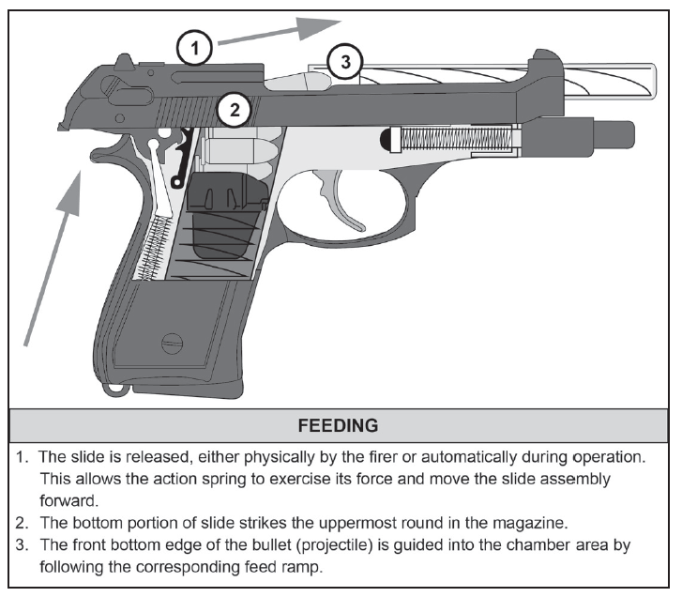

Slide 3
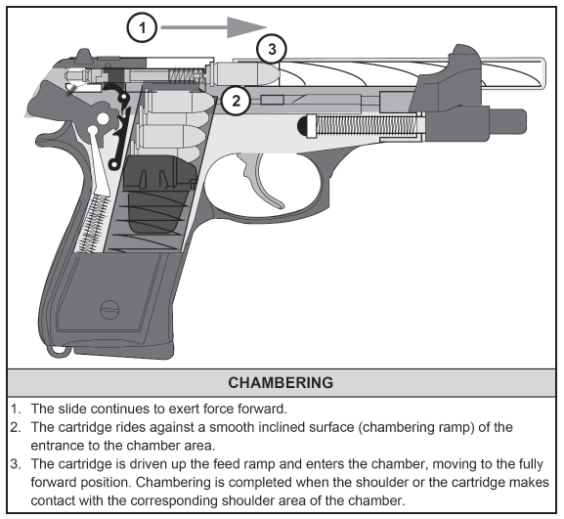

Slide 4
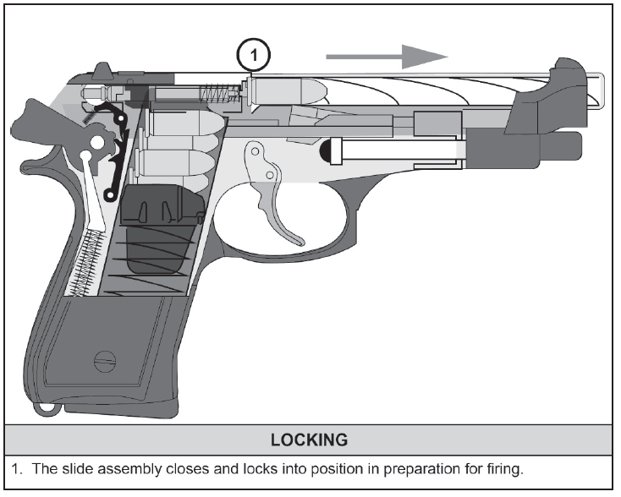

Slide 5
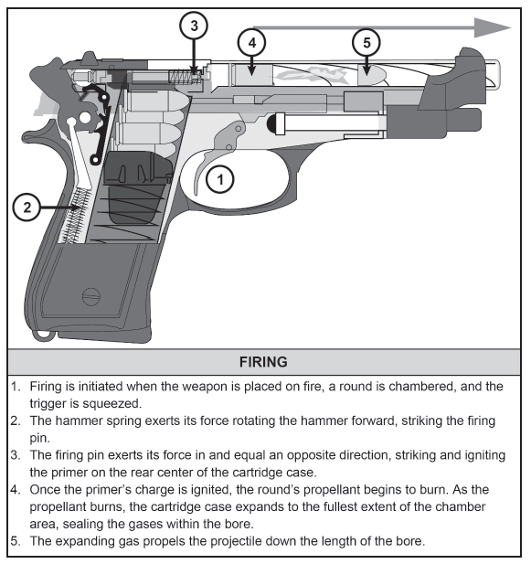

Slide 6
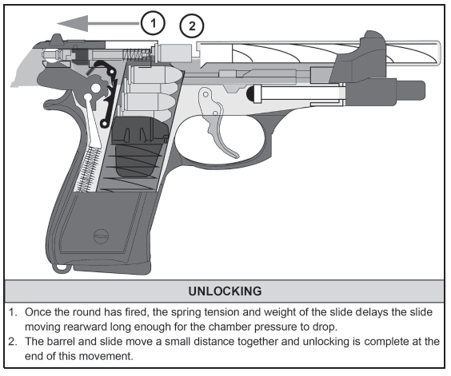

Slide 7
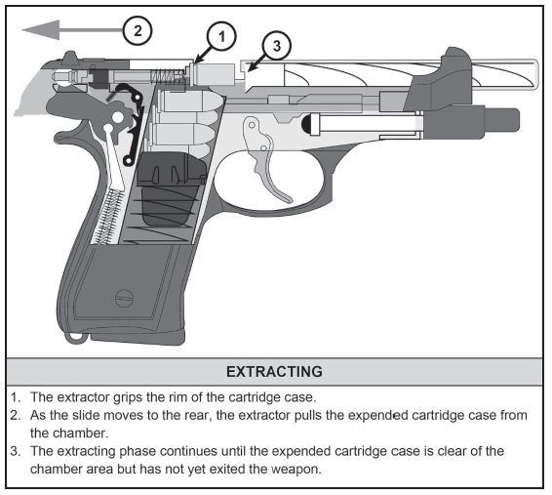

Slide 8
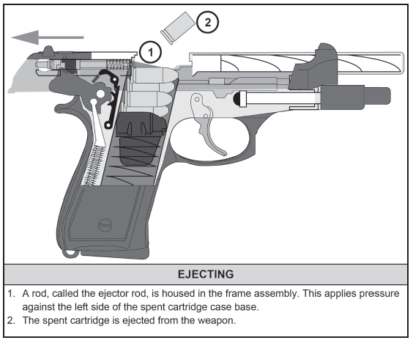

Slide 9
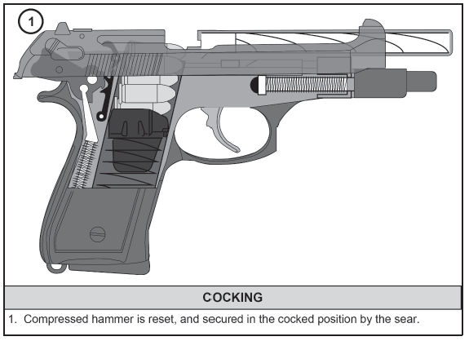

Slide 10
CHECK ON LEARNING
PRINCIPLES OF OPERATION
What are the 4 rules of firearms safety?
Rule 1: Treat every weapon as if it is loaded
Rule 2: Never point the weapon at anything you do not intend to destroy
Rule 3: Keep finger straight and off the trigger until ready to fire
Rule 4: Ensure positive identification of the target and its surroundings
What are the weapon safety status (WSS)?
Green- The weapon’s magazine is out, the chamber is empty, and its slide is locked open or forward, and the decoking or safety lever is on SAFE.
Amber- A magazine is locked into the magazine well of the weapon, the slide is forward on an empty chamber, and the decocking or safety lever is on SAFE
Red- The weapon’s magazine is inserted, a round is in the chamber, the slide is forward and locked, and the decocking or safety lever is on SAFE.

Slide 11
CHECK ON LEARNING
PRINCIPLES OF OPERATION
What are the major components?
Slide Assembly: Houses the striker assembly, extractor, sights and energizes the striker during recoil cycle.
Barrel: Holds the cartridge for firing and directs projectile.
Receiver: Supports all major components. Controls action of pistol through the major components.
Grip Module Assembly: Houses receiver assembly and magazine catch
Recoil Spring Guide Assembly: Absorbs recoil and returns the slide and barrel assembly to the forward position.
Magazine: Holds cartridges in place for feeding
What are the cycle of function?
● Feeding  Chambering  Locking  Firing  Unlocking  Extracting  Ejecting  Cocking
Notes:
Range overmatch provides a tactical engagement buffer that accommodates the Soldier’s time to engage with precision fires. For example, a Soldier that has the capability to effectively engage personnel targets at a range of 500 meters will have range overmatch of 10 to 20 percent over a threat rifleman. That 10 to 20 percent range difference is equivalent to a distance of 40 to 80 meters, which is approximately the distance a maneuvering threat can traverse in 15 to 40 seconds

Slide 12
HOLSTER REQUIREMENTS AND PLACEMENT

Slide 13
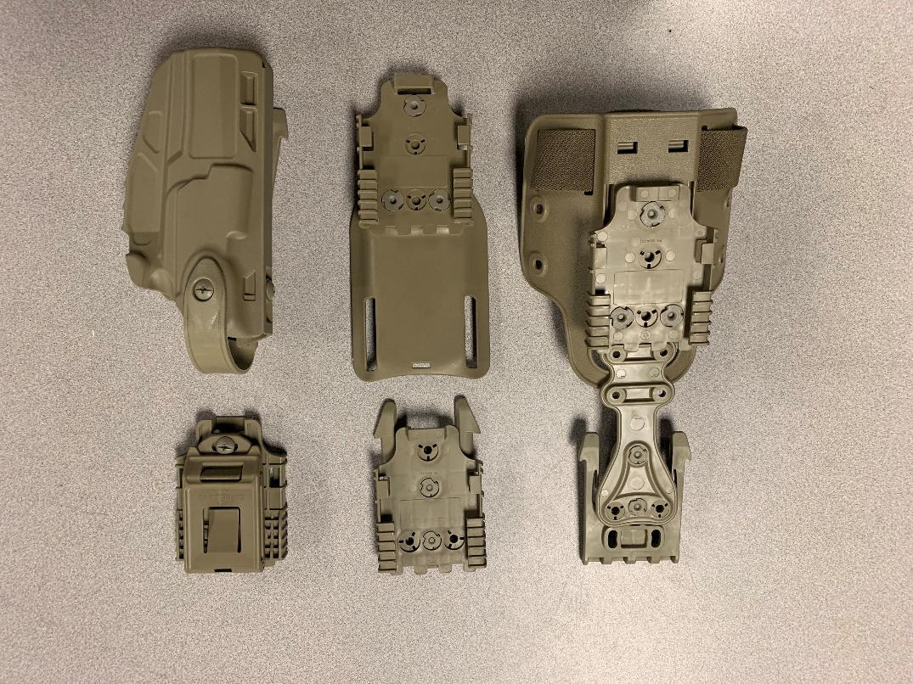
REQUIREMENTS
Requirements: Units must provide Soldiers with a holster that has a high level of retention, achieved by a friction-based grip; a mechanical retention release such as a thumb operated lever; and mounting hardware appropriate to the situation.
M17 HOLSTER SET
CURRENT ARMY AUTHORIZED HOLSTERS
Notes:
REQUIREMENTS
Units must provide Soldiers with a holster that has a high level of retention, achieved by a friction-based grip; a mechanical retention release such as a thumb operated lever; and mounting hardware appropriate to the situation. The holster should also protect the pistol from damage and debris. Figure 4-1 shows authorized holsters for use with the Army service pistol.
PLACEMENT
The proper placement of pistol gear helps ensure safety, and helps a Soldier effectively handle and employ the pistol. A holster helps the Soldier—
Maintain control of the pistol while conducting tasks that require both hands such as climbing, handling detainees, providing buddy aid, or other tasks.
Keep the enemy from taking the pistol during close quarters combat.
Access and manipulate the pistol when necessary, especially when wearing other equipment.
Conceal the pistol to perform certain jobs.
The holster should be placed midline on the hip. The Soldier should be able to take their firing arm and extend it to their side and cup their firing hand and ensure it doesn’t hit the bottom of the holster. If it does, then the holster is sitting to low and will hinder the draw.
The Soldier needs to consider the type of holster used and how the placement of the holster can impact the manner in which the pistol is drawn. Lanyards and other tethers can impede use of the pistol. Selection of the correct retention device should address concerns about the pistol becoming loose or falling from the holster.
The path that the pistol takes when drawing and re holstering MUST be free and clear of all equipment. The two most common placements of holsters for the Soldier is on the waistline and thigh.
Listed below are alternate placement methods that may be necessary due to specific mission requirements. Soldiers must modify their draw and practice from these alternate placement positions:
Chest (drivers).
Under shoulder (pilots and tank crew members).
Direct mount to IOTV (Soldiers wearing body armor).
Concealment (Soldiers requiring a low signature).

Slide 14
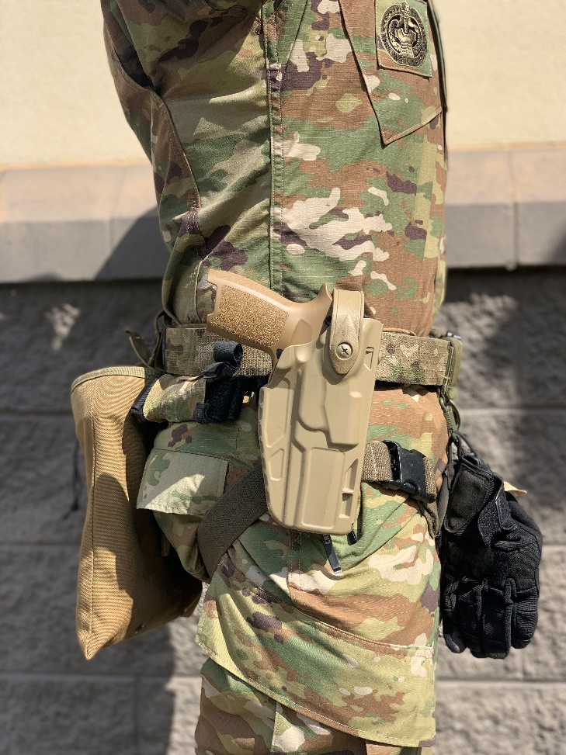
PLACEMENT
Placement: The holster should be placed midline on the hip.
Alternate Placement Methods:
Chest (drivers).
Under shoulder (pilots and tank crew members).
Direct mount to IOTV (Soldiers wearing body armor).
Concealment (Soldiers requiring a low signature).
NOTE: The Soldier needs to consider the type of holster used and how the placement of the holster can impact the manner in which the pistol is drawn.
Notes:
REQUIREMENTS
Units must provide Soldiers with a holster that has a high level of retention, achieved by a friction-based grip; a mechanical retention release such as a thumb operated lever; and mounting hardware appropriate to the situation. The holster should also protect the pistol from damage and debris. Figure 4-1 shows authorized holsters for use with the Army service pistol.
PLACEMENT
The proper placement of pistol gear helps ensure safety, and helps a Soldier effectively handle and employ the pistol. A holster helps the Soldier—
Maintain control of the pistol while conducting tasks that require both hands such as climbing, handling detainees, providing buddy aid, or other tasks.
Keep the enemy from taking the pistol during close quarters combat.
Access and manipulate the pistol when necessary, especially when wearing other equipment.
Conceal the pistol to perform certain jobs.
The holster should be placed midline on the hip. The Soldier should be able to take their firing arm and extend it to their side and cup their firing hand and ensure it doesn’t hit the bottom of the holster. If it does, then the holster is sitting to low and will hinder the draw.
The Soldier needs to consider the type of holster used and how the placement of the holster can impact the manner in which the pistol is drawn. Lanyards and other tethers can impede use of the pistol. Selection of the correct retention device should address concerns about the pistol becoming loose or falling from the holster.
The path that the pistol takes when drawing and re holstering MUST be free and clear of all equipment. The two most common placements of holsters for the Soldier is on the waistline and thigh.
Listed below are alternate placement methods that may be necessary due to specific mission requirements. Soldiers must modify their draw and practice from these alternate placement positions:
Chest (drivers).
Under shoulder (pilots and tank crew members).
Direct mount to IOTV (Soldiers wearing body armor).
Concealment (Soldiers requiring a low signature).

Slide 15
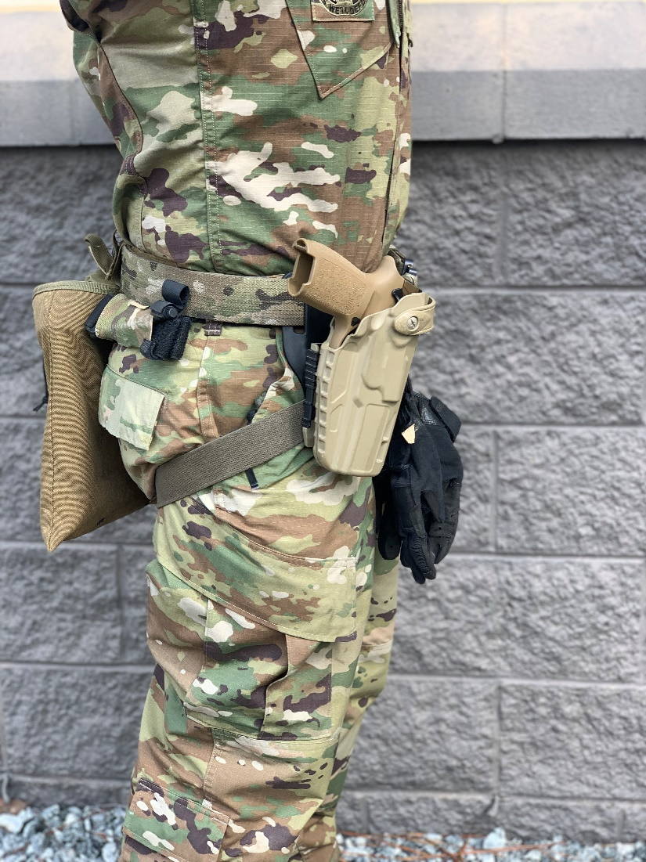
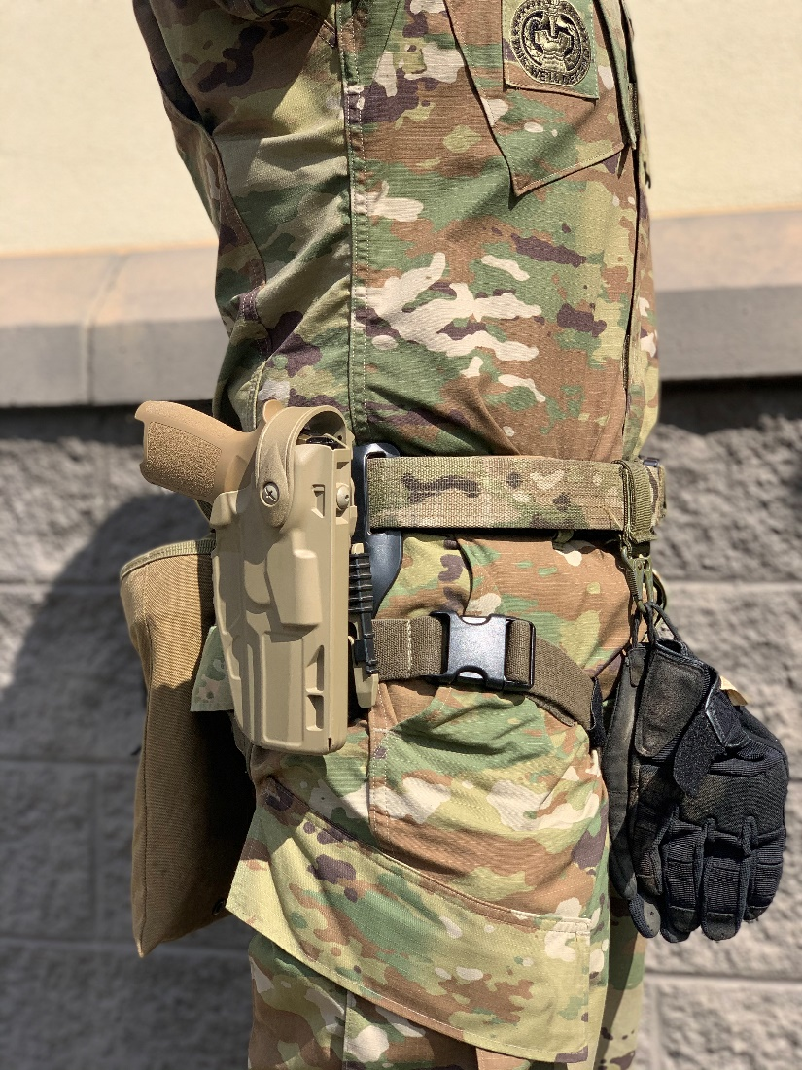
IMPROPER PLACEMENT

Slide 16
CHECK ON LEARNING
HOLSTER PLACEMENT
Where should the holster be placed at on your body?
The holster should be placed midline on the hip.
What are some alternate placement methods?
Chest (drivers).
Under shoulder (pilots and tank crew members).
Direct mount to IOTV (Soldiers wearing body armor).
Concealment (Soldiers requiring a low signature).

Slide 17
Stability, Aim, Control
Notes:
Begin by asking pointed question to get concrete knowledge of the class:
Example questions
What is Stability?
What is support?

Slide 18
STABILITY
Stability is provided through four functions:
Support
Muscle Relaxation
Natural Point of Aim
Recoil Management
Utilizing these functions as a guide a soldier can achieve a stable position.
When conducting a standing unsupported position with a pistol, what does a good stance consist of?
Feet shoulder width apart
Non firing leg slightly forward of firing leg
Majority of body weight on the balls of our feet
Knees slightly bent
Hips and upper body generally squared up with the target
Notes:
Stability is provided through four functions: support,
muscle relaxation, natural point of aim, and recoil management.
These functions provide the Soldier the means to best stabilize their
weapon system during the engagement process.

Slide 19
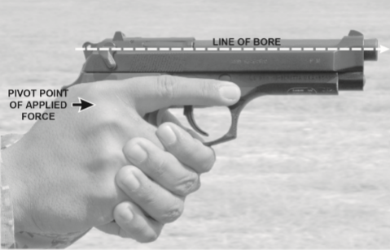
GRIP
Applying Firm and Consistent grip Pressure will help the shooter Leverage the gun to control Recoil, resulting in faster sight recovery and follow up shots.
What does a good grip look like?

Slide 20
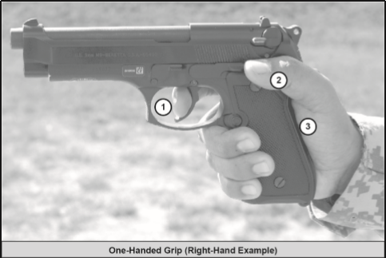
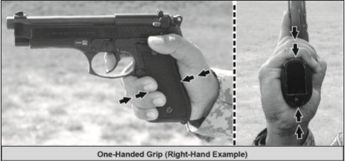
GRIP
Grip the pistol with your Firing Hand with a firm handshake grip
Trigger Finger placed naturally on the trigger
Thumb wrapped around grip
Grip is high on the frame with webbing placed against beavertail notch.
Notes:
ONE-HANDED GRIP
The one-handed grip can be used upon the first contact made with the pistol during
the draw-stroke or from the pistol transition. Figure 6-3 shows the one-handed grip. A
Soldier can use this grip to engage a target in extreme situations, such as when the other
hand is injured and the Soldier must continue to engage targets. This grip can serve as a
training tool for learning correct trigger control.

