Slide 1
91st EN BN
M9 Range Brief
160900MAY2019
OIC: 2LT Seth Mykut
NCOIC: SFC Joshua Rubach
RSO: 1LT Andy Michel

Slide 2
Agenda
Task Organization
Situation
Mission
Execution
Sustainment
Command and Signal
Risk Considerations
Commander’s Guidance

Slide 3
Task Organization
OIC: 2LT Mykut
RSO: 1LT Michel
NCOIC: SFC Rubach
Remedial Trainers: 1x NCO per 5 Soldiers
Ammo Detail: 1 NCO, 2x Soldiers
Radio Operator/Tower: SPC Stegal
Gate Guards: 2x Soldiers
MEDEVAC: PFC Younker

Slide 4
Situation
Friendly
Range Control
BN Support
Medic: Located at BWPB
Terrain
Black Water Pistol Bravo
Minimum Qualification Standard: 16/30 hits
Expected Soldiers
HHC BN | HHC BDE | A Co | B Co | C Co | D Co | E-FSC | 115th BSB
12 | 36 | 6 | 6 | 4 | 10 | 3 | 11

Slide 5
Mission
91st EN BN executes an M9 Qualification Range on 22-23 MAY at Black Water Pistol Bravo (BWPB) IOT qualify 88 91st EN BN Soldiers assigned an M9 Pistol.

Slide 6
Concept of Operation
Phase I (Prep/Movement)
- Begin: Receipt of Order
- End: Arrival of Ammo 22 0700 MAY 19
Phase II (Day 1 Execution)
- Begin: Safety Brief
- End: Day 1 Complete, AHA handoff 22 1630 MAY 19
Phase III (Overnight)
- Begin: Range cold, AHA handover complete
- End: Range reoccupied, Range Goes Hot NLT 23 0800 MAY 19
Phase IV (Day 2 Execution)
- Begin: Safety Brief
- End: Qualification Complete, NLT 1600 23 MAY 19
Phase V (Reconsolidation and Recovery)
- Begin: Qualification Complete
- End: All Maintenance conducted on vehicles and equipment, all SI is accounted for, all vehicles are washed and refueled.

Slide 7
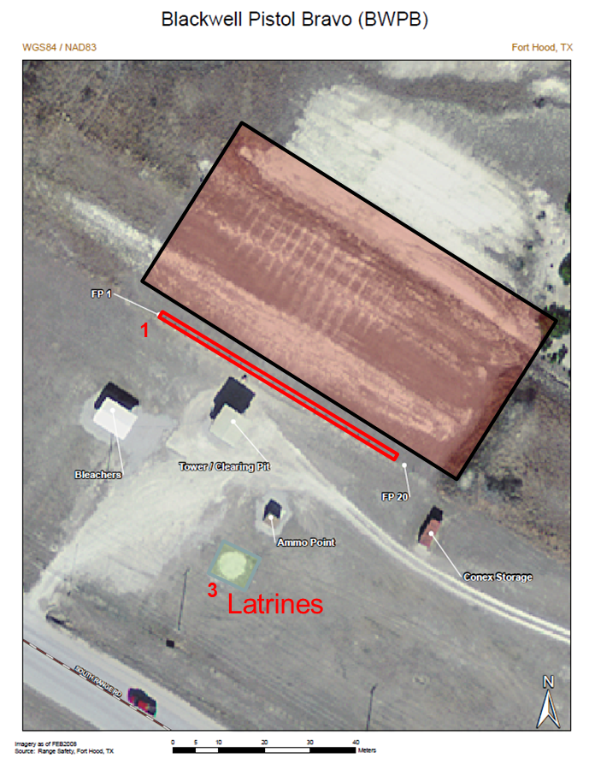
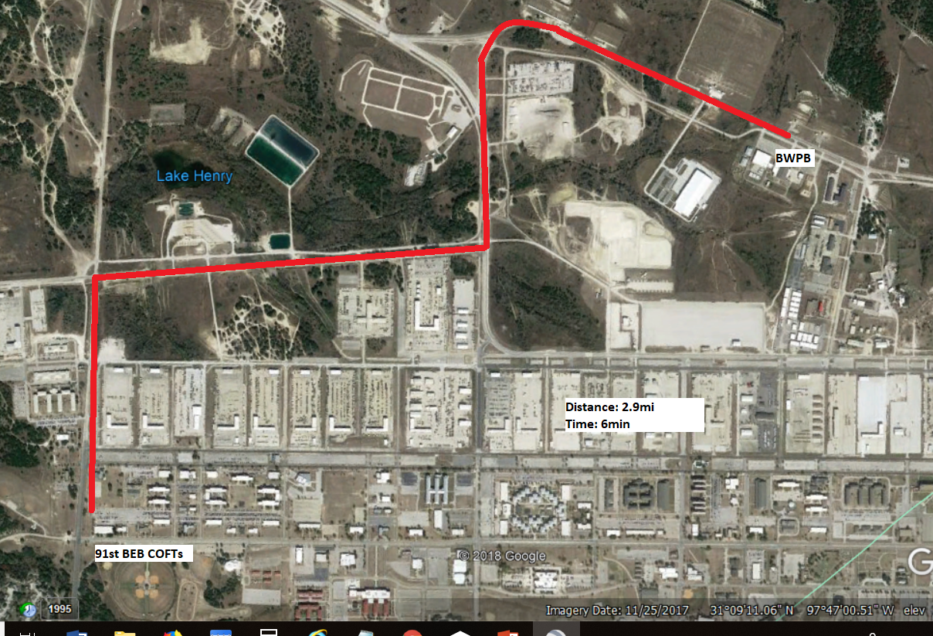
91 BEB M9 Qualification – 22/23 May 2019
Mission Statement
91st EN BN executes an M9 Qualification Range on 22-23 MAY at Black Water Pistol Bravo (BWPB) IOT qualify 88 91st EN BN Soldiers assigned an M9 Pistol.
Manning
OIC: 2LT Mykut
RSO: 1LT Michel
NCOIC: SFC Rubach
RTO: SPC Stegal
Medic: PFC Younker
AHA NCOs: TBD
Gate Guards: TBD
Retraining NCO: TBD
Concept of Operation
Prior to the range all companies conduct PMI for M9 Weapon System and range brief conducted with Saber 6 for guidance. 220600MAY2019 companies conduct weapons draw/PCC/PCI. Companies conduct movement to BWPB arriving NLT 0700. The safety brief will begin at 0715 and the range will go hot at 0800. Firers will have 5 practice rounds and then conduct Qualification Tables I-V with 1 lane safety per 3 firers. At 1600 the range will go cold and the AHA will be secured for the night. Companies will secure their weapons for the night. At 230600MAY2019 companies conduct weapons draw/PCC/PCI. Companies conduct movement to BWPB arriving NLT 0700. The safety brief will begin at 0715 and the range will go hot at 0800. Qualification will continue until complete at which time the range will go cold, be sanitized, and will be cleared with Range Ops. Remaining ammo will be turned in to E FSC.
Sustainment
Land – M9 Range, BWRB
CL I- Ration Cycle M-M, Water Buffalo
CL II- Dry Erase Board/Markers, Trash Bags, Ear Pro, 100mph Tape
CL III- CLP/spray bottles
CL V- 4,000 rounds 9MM
CL VII/Medical Coverage- CLS personnel/MEDIC (PFC Younker)
CL IX- Armorer on site
Recovery- E FSC
Timeline
160900MAY19 – Range Brief to Saber 6
220600MAY19 – Companies Draw Weapons/PCC/PCI
220700MAY19 – Firers Arrive at BWPB
220715MAY19 – Safety Brief
220800MAY19 – Range Hot/Qual Begins
221600MAY19 – Range Cold/AHA Signed Over
230600MAY19 - Companies Draw Weapons/PCC/PCI
230700MAY19 – Firers Arrive at BWPB
230715MAY19 – Safety Brief
230800MAY19 – Range Hot/Qual Begins
NLT 231600MAY19 – Range Cold
Uniform
OCPs
ACH
IOTV w/ Plates
APEL Eye Pro
Ear Pro
Gloves
Water source IAW Ft. Hood Standard

Slide 8
Phase I- Prep/Movement
Task | Time/Date | Personnel
PMI | Completed at Company Level | Company PMI Trainers
Range Signed For | 21 0900 MAY 19 | 2LT Mykut/SFC Rubach
SP from Company | 22 0530 MAY 19 | HHC Range Detail
Weapons Draw | 22 0600 MAY 19 | M9 Firers
Occupy BWPB | 22 0600 MAY 19 | HHC Range Detail
Convoy Brief/PCCs/PCIs | 22 0630 MAY 19 | Company Range Leadership
Ammunition Pickup From PKRZ | 22 0645 MAY 19 | E FSC, Ammo Detail
Ammunition Delivered | 22 0700 MAY 19 | E FSC, Ammo Detail

Slide 9
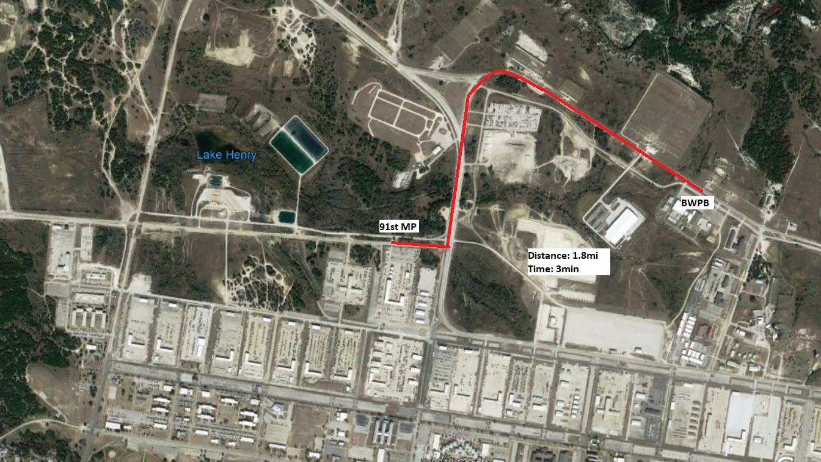
Phase I- Movement (BWPB) From Motor Pool
BGPQ

Slide 10
Phase I- Movement (BWPB) From Company COFTs
BGPQ

Slide 11
Movement of Soldiers + Weapons
Each company will be responsible for transporting their own soldiers and weapons to the range in military vehicles
PCC/PCIs will be conducted at the company level prior to movement from the company area/motor pool

Slide 12
Phase II- Day 1 Execution
Task | Time/Date | Personnel
Safety Brief | 22 0715 MAY 19 | 1LT Michel
Distribute Ammo | 22 0745 MAY 19 | Ammo Detail
Range “hot” Status | 22 0800 MAY 19 | 2LT Mykut
Ready to Qualify | 22 0830 MAY 19 | Range Detail
Range goes Cold | 22 1600 MAY 19 | 2LT Mykut

Slide 13
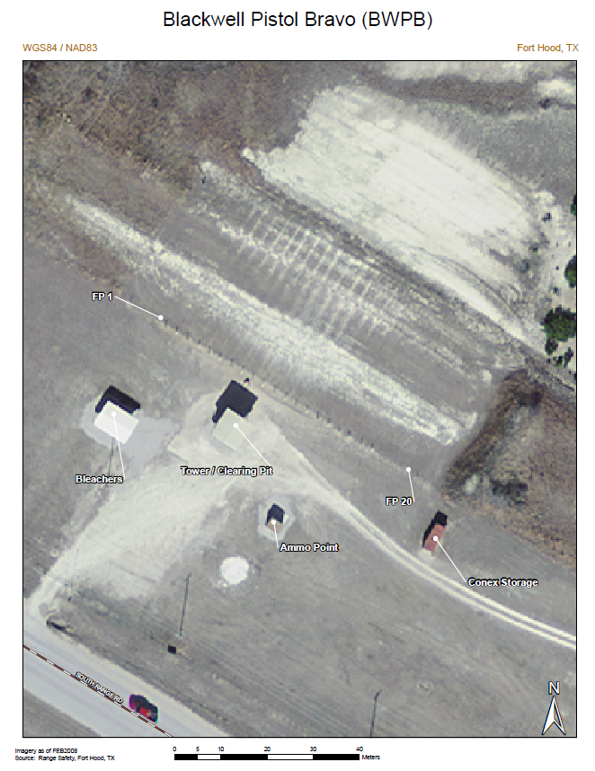
Blackwell Pistol B Qualification
Twenty (20) Lanes
Remedial Training will take place at Bleachers
Semi-Permanent Latrines are located on site
Targets are pop-up silhouettes.
1
3
Latrines

Slide 14
Remedial Training
If a Soldier is unable to qualify to standard they will conduct remedial training to include:
Analyzing form and BRM to discover Soldier’s problems
Re-train Soldier on trigger squeeze, body position, sight picture, and breathing techniques (Fundamentals of Marksmanship)
Allow sufficient breaks to prevent Soldiers from becoming fatigued
Instructors: 1X NCO per 5 Soldiers, NCOs that successfully qualify will fill this role

Slide 15
Phase III- Overnight
Task | Time/Date | Personnel
Ammo Guard Overnight Brief | 22 1600 MAY 19 | 2LT Mykut
Overnight Ammo NCO signs for AHA | 22 1630 MAY 19 | Overnight Ammo NCO
Day Ammo NCO signs for AHA | 23 0600 MAY 19 | Day Ammo Detail

Slide 16
Overnight Ammo Procedures
Ammunition will be signed from one Ammo NCO to another using the DA Form 581-1
The AHA will remain locked unless conducting ammunition inventory for turn-over
There will be a minimum of 1 NCO and 1 Soldier guarding the AHA at all times

Slide 17
Phase IV- Day 2 Execution
Task | Time/Date | Personnel
SP from Company | 22 0530 MAY 19 | HHC Range Detail
Convoy Brief/PCCs/PCIs (Weapons Draw Conducted Beforehand) | 22 0630 MAY 19 | Company Range Leadership
Safety Brief | 23 0715 MAY 19 | 1LT Michel
Distribute Ammo | 23 0745 MAY 19 | Ammo Detail
Range “hot” Status | 23 0800 MAY 19 | 2LT Mykut
Ready to Qualify | 23 0830 MAY 19 | Range Detail
Range Goes Cold | NLT 23 1600 MAY 19 | 2LT Mykut

Slide 18
Phase V- Reconsolidation and Recovery
Task | Time/Date | Personnel
Range goes Cold | NLT 23 1600 MAY 19 | 2LT Mykut
All trainers cleared off Range | NLT 23 1600 MAY 19 | 1LT Michel
Police Call | NLT 23 1600 MAY 19 | All Personnel
Ammo and Residue clean up | NLT 23 1600 MAY 19 | HHC Range Detail/ 91st EN BN Soldiers
Donnage Pick-up | NLT 23 1600 MAY 19 | E FSC
Range Inspected/Cleared | NLT 23 1630 MAY 19 | Range Control, 2LT Mykut
AAR | NLT 23 1700 MAY 19 | 2LT Mykut
Movement back to Company | NLT 23 1730 MAY 19 | HHC/Companies
Equipment Maintenance | UTC | All Personnel

Slide 19
Coordinating Instructions
Uniform
Fort Hood Field Standard:
OCP
ACH
IOTV w/ Plates
Eye Pro
Ear Pro
Gloves
Water source IAW Ft. Hood Standard

Slide 20
Qualification Procedure
Table | Ammo | Targets
I – Day Standing | 1x Mag : 7rds | 5x Single
II – Day Standing | 1x Mag : 1rd 1x Mag : 7rds | 4x Single 2x Double (1 Pair)
III – Day Standing | 1x Mag : 7rds | 3x Single 2x Double (1 Pair)
IV – Day Standing | 1x Mag : 5rds | 2x Single 2x Double (1 Pair)
V – Day Moving Out | 1x Mag : 1rd 1x Mag : 7rds 1x Mag : 5rds | 4x Single 3x Double (3 Pairs)
40rds Per Firer

Slide 21
Qualification Ratings

Slide 22
Sustainment
Class I- Ration Cycle M-M, Water Buffalo
Class II- Dry Erase Board/Markers, Trash Bags, Ear Pro, 100mph Tape
Class III- CLP/spray bottles
Class V- 4,000 rounds 9MM
Class VII/Medical Coverage- CLS personnel/MEDIC (PFC Younker)
Class IX- Armorer on site (SPC Stegal) to handle malfunctions beyond immediate action
Recovery- E FSC aware of training and on standby; no water crossing or restricted terrain along route

Slide 23
Sustainment
Maintenance:
Maintenance repairs vehicles at range as necessary
Vehicles requiring additional maintenance support are recovered back to 91 EN BN Motor Pool
Vehicle recovery procedures P: Self Recovery A: E FSC
CASEVAC
All medical incidents reported to OIC/RSO
1x Medic (PFC Younker)
Soldiers requiring additional care beyond first aid are evacuated to CRDAMC using HQ300
Air MEDEVAC will be coordinated through Range Control if required

Slide 24
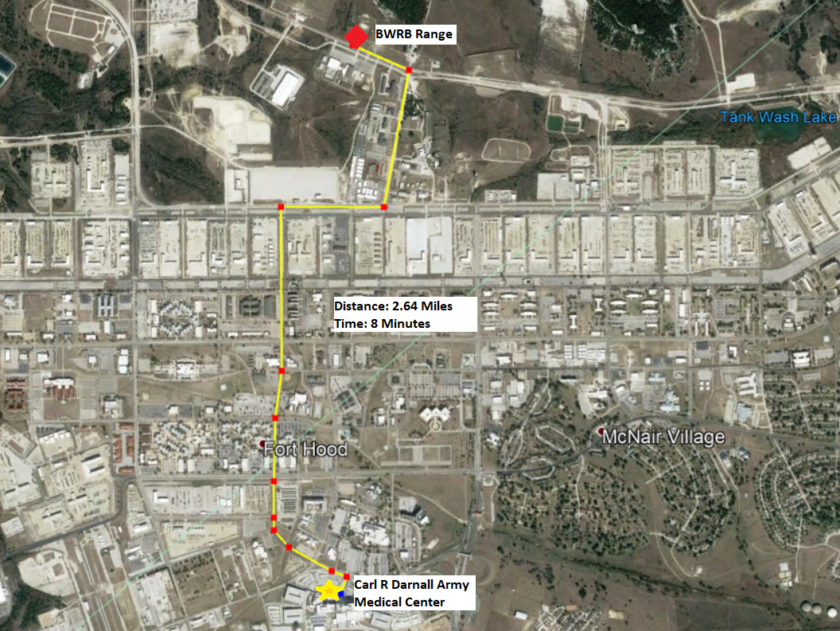
CASEVAC Vehicle Route (Primary)

Slide 25
CASEVAC Vehicle Route (Alternate)

Slide 26
Command and Signal
Succession of Command:
OIC
NCOIC
Retraining NCO
Signal:
(Range to/from Range Control/BN HQ)
P- FM Radio/Tower Radio (OIC, Tower)
A- FM Radio Communications (NCOIC, Vehicle)
C- Cell Phone (OIC)
E- Runner
Internal Communication: P - MBITR Radios, A - Runner
Range Control Operations: 254-287-8203
Range Conrol FM: Primary- 30:45, Alternate- 38:30
91st EN BN Staff Duty: 254-287-1018

Slide 27
Rehearsals
RTO Coordination Rehearsal
Who: RTO for the tower
What: Practices the firing script
When: At least the week prior to the range
Where: COFTs
Rollover Drills
Who: All personnel traveling in military vehicles
What: Practice proper rollover procedures
When: Prior to SP
Where: Motor Pool or COFTs
CASEVAC Rehearsal
Who: Medic and Driver
What: Drive both the primary and alternate routes
When: The day prior to the range
Where: BWPB to CRDAMC
Range Sync Rehearsal
Who: All range personnel
What: Go over all facets of range operations, ensuring everyone has knowledge of all moving parts
When: The day prior to the range
Where: On site at BWPB

Slide 28
Major Risks and Mitigation
Safety Coverage:
- There will be no less than 1 safety for every 3 lanes firing, no exceptions.
Undisciplined Operations (i.e. Negligent Discharge):
- In order to enter the range all personnel will be required to have a memorandum from their commander stating that they have completed PMI. Any unsafe acts will result in immediate expulsion from the range and potential recommendation of UCMJ action.
Vehicle rollover due to high speeds:
All vehicles will follow posted speed limits at all times. Rollover drills will be conducted by all vehicles prior to SP.
Misfires/Round Stoppage/Duds:
If a round does not fire after immediate action, firer will keep pistol pointed down range while lane safety inspects and clears round out of the pistol.

Slide 29
Requirements
OIC: 2LT Mykut
NCOIC: SFC Rubach
RSO: 1LT Michel
Medic: 1x soldier (PFC Younker)
Water buffalo: 1x from HHC Co (R400W)
Ammo Detail: 1x NCO, 1x soldiers
Safeties: 6x NCOs at all times (1 safety/ 3 lanes) companies need to supply 2-3x E-5 and above to provide safeties so other safeties can qualify.
Gate-guard: 2x HHC soldiers (on radio)
Vehicles: 4x personnel to operate
1x LMTV (HQ300)
1x HMMWV (TBD)

Slide 30
Questions and Guidance

