Slide 1
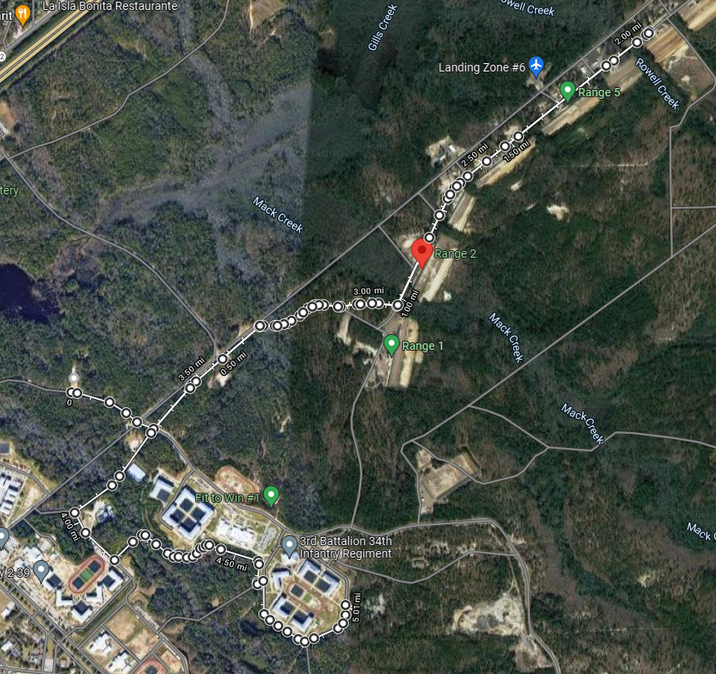
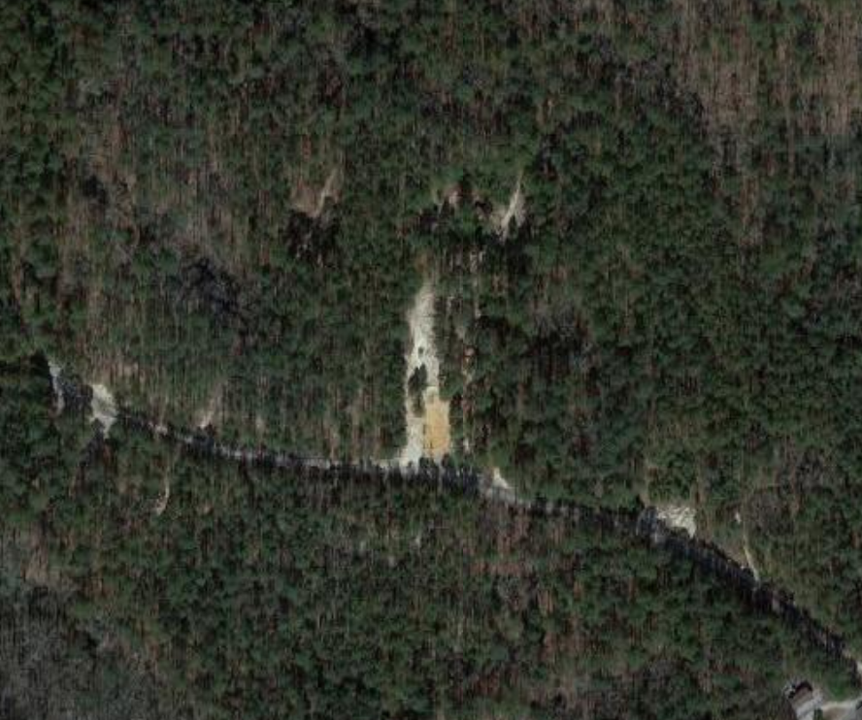
C CO – The Hammer
Mission: C/1-13 IN conducts FTX 1 - THE HAMMER from 28NOV2022 to 29NOV2022 IVO BA 2 IOT train and evaluate skill level I tasks in a field environment, preparing Trainees for the Anvil and Forge 2.0.
CP1
Concept of Operations:​
Phase I (Preparation): will be executed from 23 NOV – 26 NOV, beginning with prerequisite training on Hammer tasks and ending with final PCC/PCI prior to movement.
Phase IIa (Movement): Will begin at completion of all PCC/PCI NLT 280500NOV2022 and end upon arrival of BA 2. At 0600 FM will begin from C CO CTA at a 20 min/mile pace for 1.4 miles to BA 2.
Phase IIb (Occupation): Begins upon arrival at BA 2 and ends once BA 2 is occupied. PLTs get 100% accountability of personnel and equipment and conduct priorities of work to establish patrol bases.
Phase IIIa (Execution): Begins once patrol bases are occupied NLT 280900NOV2022 and ends NLT 290430NOV2022. Platoons conduct lanes in a round robin that consist of IMT, FOOM, METT-TC, React to Idf, CBRN, EPW, A&L, React to contact, 9-Line, TCCC, Care under Fire, LDA, and Break Contact.
Phase IIIb (Night Execution): Begins NLT 282000NOV2022 and will consist of NVG training and patrol base activities by all cadre.
Phase IV (Redeployment): Begins NLT 290600NOV2022 from BA2 to CoC and will end upon return to C CO CTA at 1530
Phase V (Recovery): Recovery Operations begin NLT 291530NOV2022 and end NLT 292000NOV22.
BA 2
SP
+ Biv7 to Range Road
+Range Road to Dixie
+Dixie to Golden Arrow
+Golden Arrow to Hartsville Guard
+Hartsville Guard to CBRNE
+CBRNE to COC
-4.98 MILES
CP2
RP
AO CRUSADER
BA 2
Timeline:
28 NOV
0430: Wake Up/ Hygiene/ Bay
0430: Company Sync
0500-0600: Formation (PD, HSD) Final PCC/PCI and MORE rations consumed
0600-0700: Step for the Hammer
0700-0745 Foot checks, Platoon occupy patrol base
0745-0815: Breakfast chow (allow second portion of more meal)
0815-1000: Setting hasty fighting positions in patrol base
1200-1230: Lunch (MRE)
1230-1800: Round Robin (1.5 hrs per lane)
1800-1900: Dinner Chow (HOT A’s)
1900-2100: Prep for night Classes
2100-2200: NVD Familiarization/Movement
2200-2300: Improve Hasty Fighting Position/ Personal Hygiene 2300-0430: Patrol Base Operations (33% Security)
0430: Wake up/Hygiene & sick call runner
0430-0530: Fill in fighting positions/ sanitize clean TA
0530-0600: Breakfast MRE
0600-0830: FM2 to COC
Sustainment:
CL I: Day 1: M-M-A (24 Boxes), MORE meal prior to SP
Day 2: M-M (24 Boxes)
Conduct Ice check every three hours during operations and refill when at or below 25% capacity. Coolers on hand to keep ice during refill.
CL III: Resupply POL at designated fuel points when vehicles are at 50% threshold
Class V: 5000 x 5.56 blank, Pyro
Class VII: 4x BRICs, 5x ASIP, 9x SAW’s 4 Rescue Randy's, x1 Boom Cannon
1x LMTV, 1x 1-Ton Water Buffalo, GSA Van, 1x HMMWV
Class VIII: 4x Litters, 4x CLS bags, Wet Bulb, 4x Foot Care Kit
N
2nd
4th
P: Radio | A: Cell Phones | C: BRIC | E: Runner | EMS: 751-91111
3rd
PLAN​ | OPORD​ | RECON​ | CERT LEADERS​ | REHEARSE​ | EXECUTE​ | AAR​ | RETRAIN​
09NOV22 | 18NOV22​ | 18NOV22​ | 23NOV22​ | 26NOV22​ | 28NOV22​ | 30NOV22​ | 30NOV22

