Slide 1
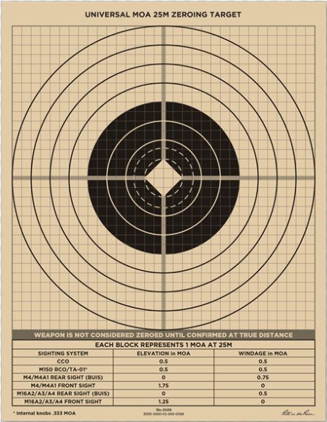
PLAN AND PREPARE

Slide 2
Action:
Develop a Unit Small Arms Marksmanship Training Plan
Conditions:
In a classroom environment given applicable marksmanship references, calculator, pen/pencil, and paper.
Standards:
Student will develop a Unit Small Arms Marksmanship Training Plan IAW Command Training Guidance, and all applicable references.
Learning Domain - Level: Cognitive – Applying No JPME Learning
Areas Supported: None

Slide 3
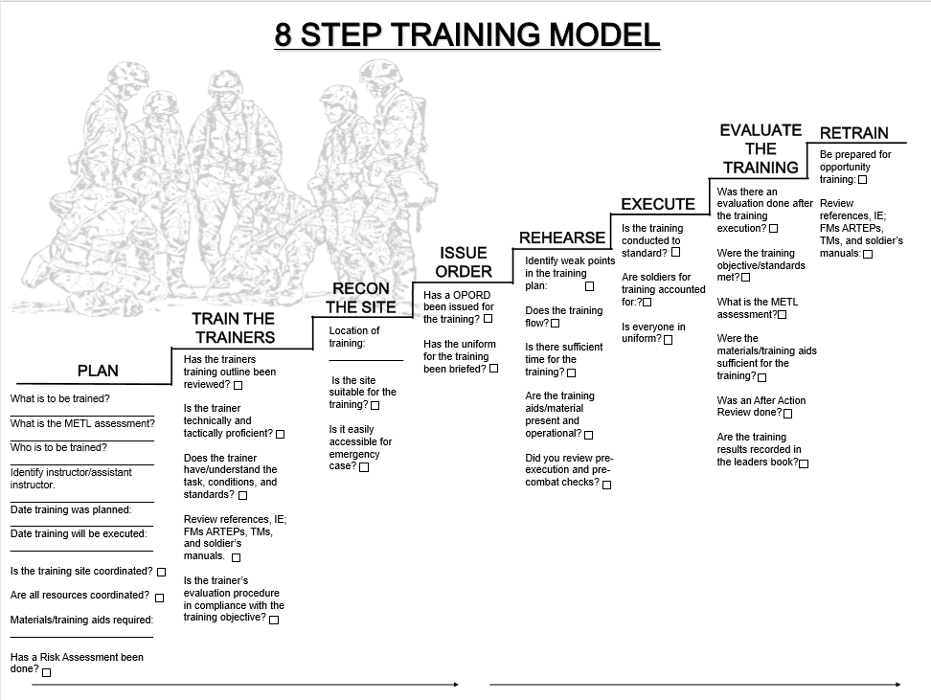

Slide 4
Battalion Master Gunner/Unit Training SME (MMT).
In conjunction with S-3
Train unit training SME’s and NCO’s assigned to the battalion on live-fire-related topics.
Assist the battalion commander and command sergeant major select candidates for unit training subject matter expert functional courses.
Certify evaluators and skills test evaluators.
Track safety and maintenance messages.
Consolidate unit live-fire training records and provide analysis to the commander on unit proficiency, training gaps, training weaknesses, and overall performance.
Manage the battalion ammunition, land, and range resourcing accounts through TAMIS and RFMSS.
Develop and implement new training techniques to improve live-fire training.
Notes:
Focus on the red highlights and have the students participate in expanding on the keys; Training SME’s, Certifying, Management.

Slide 5
Battalion Master Gunner/Unit Training SME (MMT).
In conjunction with S-3
Develop battalion level live-fire training plans.
Monitor company live-fire training plans.
Coordinate with brigade for direct-fire training assets.
Coordinate for the certification of range safety personnel.
Provide assistance for direct-fire planning while deployed.
Notes:
Note. For units that do not have a specific Master Gunner assigned or authorized, the commander should select an experienced NCO to support the UTPs. Typically, the selected Soldier will perform the functions of the training SME as an additional duty. It does not remove or replace the roles and responsibilities of the leadership, staff, or chain of command during planning, preparation, or execution of training.

Slide 6
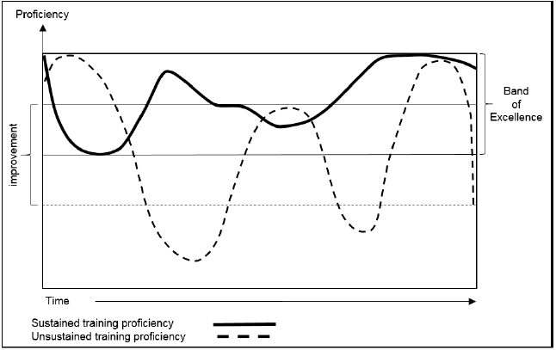
SUSTAINING PROFICIENCY
Band Of Excellence
Notes:
A unit’s training readiness is directly tied to its training proficiency. That proficiency naturally
fluctuates over time and in response to various factors. Each unit encounters and adjusts to these factors, including training frequency, key personnel turnover, new equipment fielding, and resource constraints.
Well-trained units seek to minimize significant variances in achieved training proficiency over time. This is
training in a band of excellence. This common sense approach precludes deep valleys in proficiency that
occur when units lose their training proficiency. Failing to sustain proficiency requires more resources and
time to retrain the unit. Training within a band of excellence is the key to sustaining long-range training
readiness.
Before developing any UTP, the commander must make a complete assessment of the unit’s proficiency, training strengths, their weaknesses, and the standards they wish to achieve. This assessment must be comprehensive to design training to achieve, improve, or sustain proficiency. Commanders assess and evaluate all aspects of training, including the planning, preparation, and execution. Leaders continuously monitor the unit's METL proficiency to determine a quantifiable picture of the unit’s current direct-fire training proficiency. From this assessment, the unit can develop a training plan to correct deficiencies, improve mastery, and sustain fundamentals.

Slide 7
WARFIGHTING SKILLS
All Soldiers Must-
Detecting, identifying, and classifying threats, or discriminating them as friendly or neutral.
Acquiring and engaging threats in an urban, woodland, or desert environment.
Engaging stationary, moving threats and successive threats while stationary and moving.
Engaging single and multiple threats in a chemical, biological, radiological, and nuclear(CBRN) environment.
Engaging single and multiple threats at night and limited visibility.
Engaging threats from a stationary protected and unprotected firing position.
Calling for indirect fire (high explosive, smoke, and illumination).
Calling for medical evacuation (MEDEVAC) and CASEVAC.
Calling for support (such as, close attack aviation and unmanned aerial systems).
Notes:
The unit training plan (UTP) is the unit’s overarching plan to attain key collective task (KCT) proficiency. As part of achieving the KCT proficiency, units develop their live-fire training plans. Every live-fire training event is led and managed through the operations process (plan-prepare-execute-assess). They are planned and coordinated in detail well before execution to ensure the training objectives are synchronized with the unit’s KCTs. Live-fire training is just one series of events that support the unit’s overall proficiency for combat, and is critical to the unit’s success.
The concepts of the “T-week” (active component) and the “T-month” (reserve component) are used to provide a sequential framework that ensures all critical actions are completed before and after the training event is conducted. This process has to start early enough in the planning cycle to ensure all resources required to train are present and accounted for as the training begins.
The T-week concept provides a framework and a backward planning method that provides specific considerations for the planning and coordination necessary for each training event. The T-week concept helps ensure that all significant actions necessary to execute the training are considered and completed in a timely manner. Although the following description is extensive, it is generic. It does not take into account each unit or installation’s particular requirements for planning and coordination. The T-week concepts support but do not replace the detailed planning used by a unit to execute the Army doctrinal training model.

Slide 8
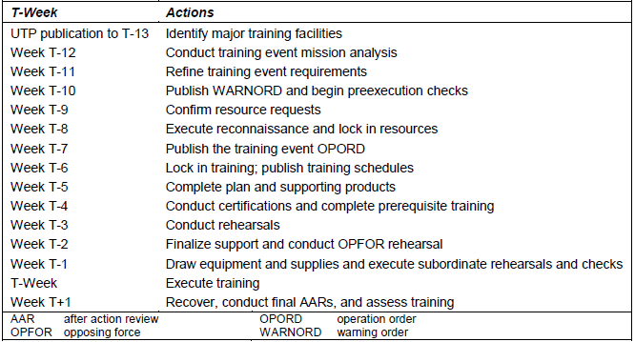
TASK WEEK
Notes:
The unit training plan (UTP) is the unit’s overarching plan to attain key collective task (KCT) proficiency. As part of achieving the KCT proficiency, units develop their live-fire training plans. Every live-fire training event is led and managed through the operations process (plan-prepare-execute-assess). They are planned and coordinated in detail well before execution to ensure the training objectives are synchronized with the unit’s KCTs. Live-fire training is just one series of events that support the unit’s overall proficiency for combat, and is critical to the unit’s success.
The concepts of the “T-week” (active component) and the “T-month” (reserve component) are used to provide a sequential framework that ensures all critical actions are completed before and after the training event is conducted. This process has to start early enough in the planning cycle to ensure all resources required to train are present and accounted for as the training begins.
The T-week concept provides a framework and a backward planning method that provides specific considerations for the planning and coordination necessary for each training event. The T-week concept helps ensure that all significant actions necessary to execute the training are considered and completed in a timely manner. Although the following description is extensive, it is generic. It does not take into account each unit or installation’s particular requirements for planning and coordination. The T-week concepts support but do not replace the detailed planning used by a unit to execute the Army doctrinal training model.

Slide 9
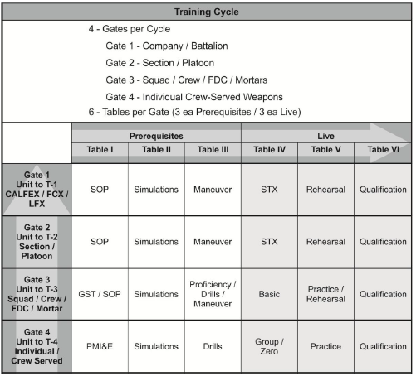
IWTS ELEMENTS
Notes:
The Principles used to develop IWTS are:
First tasks First: Update existing qualification tables to ensure critical tasks expected of all Soldiers are trained and tested. This includes identifying training gaps, developing solutions, and applying them within the guidelines of the strategy review.
Maximize simulations and gaming: Augment the live-fire training strategy with an effective and efficient use of available simulations that build to and enhance the subsequent live-fire training events.
Synchronized components: Each component strategy must ensure it complements and is synchronized with other weapon strategies. Synchronized components must allow effective integration in collective training events to maximize command flexibility.
Adaptable to change: The strategy is designed such that it easily adapts to current and future Army guidance..
Establish progressive and Gated events: Gated events are prerequisites that must be completed before executing the next training event. This enables the strategy to secure resourcing, train and test the fundamentals, and build upon previous training event’s outcomes and displayed proficiencies.
Culminate in combined arms collective training events: All individual components of the strategy culminate in a collective combined arms live-fire event. This facilitates the “train as you fight” concept across all echelons and formations and provides the commander the capability to seamlessly integrate combined arms assets and external warfighter functions (WFFs) into collective, combined arms training events.
Facilitate rapid deployment capabilities: The system must provide a high level of proficiency early in the training cycle to provide the nation small unit through brigade combat team (BCT) decisive action capabilities.
Adaptive to combined arms training: Ensure all updated components are effectively linked and integrated with other weapon strategies in a supporting, collaborative, and cooperative method, building on previous training outcomes.
Provide commander flexibility: Commanders must have the flexibility during collective training to support their directed mission, expected operating environment, and desired force structure.

Slide 10
PROGRESSIVE INTEGRATION
Tier 4- Individual, Special Purpose, and Crew Served Weapons
Table I: PMI (up to 6 weeks prior)
The Functional Elements of the Shot Process;
Firing Positions
Sights
Ballistics and Zeroes
Wind and Weather
Shooter Target Analysis
Coaching- Shadow Boxes, Laser Bore-Light
Knowledge Test (written). *
Table II: Simulations (up to 6 weeks prior)
Engagement Skills Trainer (All tables through A011*)
Table III: Drills (up to 6 weeks prior)
Drills A-K, Appendix D TC 3-22.9*
Day/ *Night
Table IV: Group/Zero (up to 3 days prior)
Boresight/ Small Arms Collimator prior to coming to range
25 Meter Zero
Confirm at true distance (e.g. LOMAH or KD Range) *
Day/ Night
Table V: Practice Record Fire (up to one day prior)
Optional to the Commander
Day/Night
Table VI: Record Fire
Must pass at a 57.7 percent (23 out of 40)*
One attempt to qualify for anything past qualified, may retest in 45 days to increase score.
Externally evaluated; another platoon’s RSO/OIC runs the tower.
Day/Night
*= Gated event for each table
Notes:
The focus is to train and qualify Soldiers on their assigned individual or crew-served weapons.
The IWTS requires the Warrior Leader Tasks are completed at the unit level for all Soldiers. Warrior Leader Task proficiency facilitates integrated collective tasks during follow-on gates. The unit selects which warrior tasks will be trained and evaluated

Slide 11
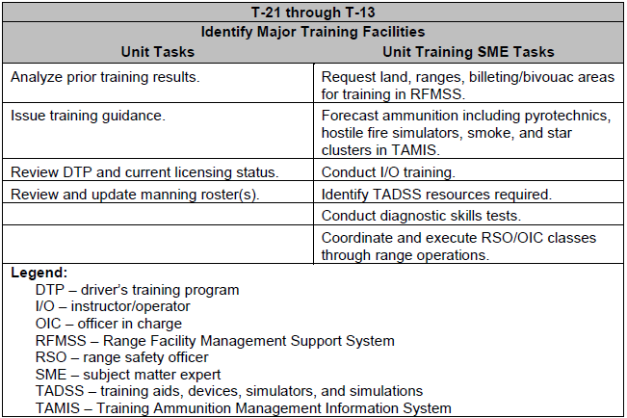
TASK WEEK
Notes:
During T-21 through T-13, units identify the major training facilities required to execute their training plans. Units must follow local standard operating procedures (SOPs) to secure facilities, which may not follow this timeline.
Munitions forecasting conducted according to AR 5-13. For example, units must consider the fire hazards during the training event and coordinate for ball only small arms ammunition availability. The unit must coordinate closely with the installation ammunition office (or similar agency) for sufficient “instead of” quantities, how to draw them when necessary, and how to forecast those unresourced ammunition types.
Developing the tentative training timeline provides backwards planning during the execution weeks of the training event. Units will be able to de-conflict training issues earlier, and ultimately secure the facilities, training areas, and ranges required at the earliest opportunity.
Table III for any supporting training strategy requires TADSS. The unit must schedule these items well in advance based on the installation’s policies. This equipment is provided in finite quantities on the installation. Coordination of accurate training sets required allows for the installation’s training support center (TSC) to order, receive, process, and issue additional equipment based on the unit’s requirements.
To provide sustainment training for the key skills, the unit should conduct diagnostic skills tests (Table I). The diagnostic test identifies training deficiencies early to apply the appropriate amount of training before the required Table I executed between T-6 and T-week.
Units should identify all the individual, crew, and leader required certifications, qualifications, schools, classes, programs, and licenses that support the future training events. Driver’s training, ammunition handlers, certified instructor/operators, range safety, and TADSS installation/troubleshooting are just a few of the most common training and certifications that need to be planned for before training execution week.

Slide 12
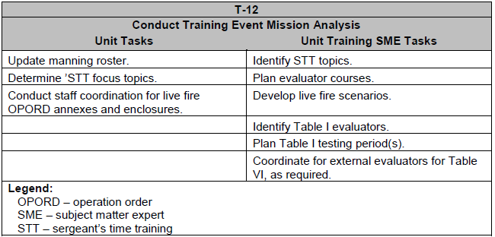
TASK WEEK
Notes:
The focus of T-12 is for units to conduct a training event mission analysis and troop leading procedures. Gathering the information required to conduct training event planning is critical to developing successful training events. Units capture historical training records, after action reviews (AARs), maintenance status, Soldier and leader certifications, and other key training indicators to support the analysis.
Units must identify all prerequisite training, certifications, qualifications, and requirements to support the training. This includes a detailed review the enablers used to support training.
During T-12, units consider and plan the available sergeant’s time training (STT) periods available, and should include live-fire individual, buddy team, fire team, squad, and crew tasks.
From T-12 through T-1, simulations and gaming training (echelon dependent) are conducted monthly. The unit training SME must monitor the unit’s progress and ensure completion of Table II. Unit training SMEs should review the certified instructor/operators of the simulations and gaming systems, as well as the available number of certified vehicle crew evaluators (VCEs). Units should use certified evaluators for all Table

Slide 13
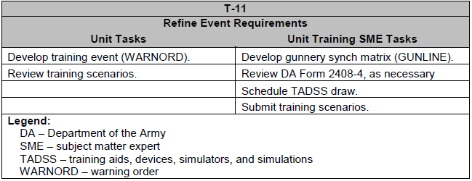
TASK WEEK
Notes:
The focus of T-11 is to refine the event training requirements based on previous training results. This focus identifies the training trends and gaps of the unit’s current proficiency to address them in the commander’s guidance as needed. The unit training SME monitors progress in simulation and gaming systems, and develops the testing plans to meet the live-fire prerequisites. The unit may develop and publish warning orders (WARNORD) to support the upcoming training event, as necessary.
Analyze previous training results available to the unit. Schedule additional training or retraining as necessary to support the training plan.
Provide planning guidance for concurrent training, follow-on collective training events (Gate 2 and Gate 1), and maneuver training. The training tables provided in Gate 4 and Gate 3 are the foundation for the collective training tables (Gate 2 and Gate 1) within the IWTS. Units must ensure the planned training supports any collective training beyond Gate 3.
Review scenarios to ensure they support the commander’s guidance and intent. Once complete, the unit training SME submits the scenarios to range operations and coordinate for the appropriate targetry, battle effects simulators, and pyrotechnics. Units must refer to local and installation range SOPs to ensure the appropriate lead time is provided for scenario approval.
The unit training SME develops the gunnery sync matrix, or GUNLINE, for the training event. Typically, this is placed on a spreadsheet to show specific ranges or training areas by day, the unit executing the training, and the type of training executed. The GUNLINE allows synchronization of the unit’s efforts, provides a visual representation of the overall live fire, and supports the tasks to subordinate units and specific instructions in the OPORD.
The unit training SME must review all DA Form 2408-4 for accuracy and to identify any weapon or system that may reach the threshold tube-wear, as appropriate for the unit type. These cards must maintain the maintenance actions taken on the armament, including actions like recoil exercises, breech or breech ring replacements, and borescope results.
The unit training SME develops and schedules the TADSS plan through the local training support center (TSC). The TADSS plan must include all equipment and devices to support the prerequisite and live training, as appropriate. This may include coordination with range operations to acquire target lifting mechanisms, scaled or full-scale targetry, battle effects simulators, generators to run the equipment, and a hand-held targetry controller. Some units may require dummy ammunition that is not supplied by TSC, but must be ordered through TAMIS or the ammunition supply point on the installation.

Slide 14
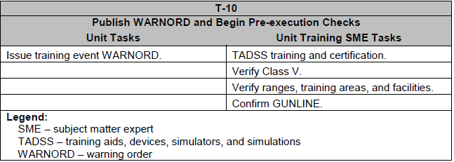
TASK WEEK
Notes:
The focus of T-10 is to publish the training event WARNORD to allow the supporting staff and leaders’ initial planning guidance and tasks. The unit determines the operational environment the training should replicate for target type, range to target, scenario development, and any supporting tactical tasks.
Publish WARNORD to units. The order must contain sufficient information for the supporting staff to begin preparation for the training event. This includes items such as the required classes of supply, external evaluation requirements, internal training that supports the training event, and in-progress review schedules.
Issue WARNORD for the Table I, Skills Test, as appropriate. If Table I is conducted in a decentralized manner, units should provide separate guidance and orders.
Verify ammunition requirements. Update DRAFT OPORD for Class V requirements. Coordinate Class V plan for each range and training event by crew and unit.
Schedule TADSS operator, installation, troubleshooting, and alignment classes as appropriate. This training is critical to the success of Table III, Proficiency Course.
Verify all ranges, training areas, and facilities required for Table I, Table III, and the live-fire training events. This includes any required use of wash rack facilities, weapons zeroing or screening procedures, and hard stand maintenance requirements. If the unit will be establishing an ammunition holding area (AHA), the unit must confirm the appropriate approved location(s) through range operations. The unit training SME may have to de-conflict multiuse facilities, external unit requests for the same range or facility, and other issues that negatively affect the GUNLINE.
Once all tasks are verified, confirm the GUNLINE and provide the updated information to the S-3 to incorporate into the live-fire OPORD as appropriate.

Slide 15
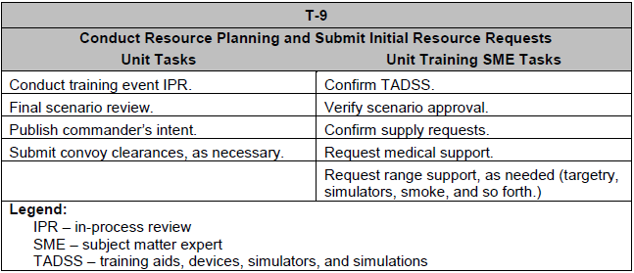
TASK WEEK
Notes:
The focus of T-9 is for units to develop and plan for the appropriate resources to support the training event. This includes all classes of supply, facilities, and external support. (See table 2-5.)
The unit establishes a clear series of IPRs for the training event. These begin after the WARNORD is published during T-10 at a biweekly frequency. Once the unit reaches T-6, IPRs are conducted weekly.
The unit reviews the final scenario developed by the unit training SME. Once complete, the unit S-6 in coordination with the unit training SME creates the appropriate digital free text, combat message situational reports (SITREPs), graphics, and icon population messages. The S-6 has the direct responsibility to support the digital traffic required to support the live-fire event, including any field manual (FM) or digital requirements for the Call-For tasks completed concurrently with live fire.
The S-3 publishes the commander’s intent for the training event. This includes the focus of the live fire, use of digital communications, SOP and tactical standard operating procedure (TACSOP) reviews, simulations use in support of the training event, prerequisite training and certifications, and the end state of training. Units include the guidance supporting “high crew” for each firing platform type, and award recommendations for exceptional performance.
The unit S-4 submits any required convoy clearance requests as appropriate for the installation. The S-4 coordinates with the unit’s supporting Cavalry scouts to conduct a route reconnaissance to ensure the route of march supports any tactical or administrative convoys. The S-4 coordinates with the installation or supporting unit military police for any escort or traffic control support.
The unit training SME must finalize the TADSS plan, including draw, training, issue, and turn in. This includes any vehicles required to support the TADSS installation and use instruction, inclement weather areas for training, and any detail support required.
The unit training SME must conduct a follow-up with range operations to ensure the range scenario is approved. Once complete, any additional documents to support the scenarios should be coordinated with range control, including targetry, thermalization of the target presentations, pyrotechnics support, and battle effects simulator use.
The unit training SME must coordinate directly with the unit medics to review the medical support package provided on each range. This includes reviewing the status of the certified combat life savers within the unit, ambulance exchange points (AXP), MEDEVAC procedures and equipment, strip maps, and communications requirements. The unit’s medic support team provides the evaluation procedures and plans to conduct the Call-For MEDEVAC and Call-For CASEVAC training requirements on the range.

Slide 16
TASK WEEK
Notes:
The focus of T-9 is for units to develop and plan for the appropriate resources to support the training event. This includes all classes of supply, facilities, and external support. (See table 2-5.)
The unit establishes a clear series of IPRs for the training event. These begin after the WARNORD is published during T-10 at a biweekly frequency. Once the unit reaches T-6, IPRs are conducted weekly.
The unit reviews the final scenario developed by the unit training SME. Once complete, the unit S-6 in coordination with the unit training SME creates the appropriate digital free text, combat message situational reports (SITREPs), graphics, and icon population messages. The S-6 has the direct responsibility to support the digital traffic required to support the live-fire event, including any field manual (FM) or digital requirements for the Call-For tasks completed concurrently with live fire.
The S-3 publishes the commander’s intent for the training event. This includes the focus of the live fire, use of digital communications, SOP and tactical standard operating procedure (TACSOP) reviews, simulations use in support of the training event, prerequisite training and certifications, and the end state of training. Units include the guidance supporting “high crew” for each firing platform type, and award recommendations for exceptional performance.
The unit S-4 submits any required convoy clearance requests as appropriate for the installation. The S-4 coordinates with the unit’s supporting Cavalry scouts to conduct a route reconnaissance to ensure the route of march supports any tactical or administrative convoys. The S-4 coordinates with the installation or supporting unit military police for any escort or traffic control support.
The unit training SME must finalize the TADSS plan, including draw, training, issue, and turn in. This includes any vehicles required to support the TADSS installation and use instruction, inclement weather areas for training, and any detail support required.
The unit training SME must conduct a follow-up with range operations to ensure the range scenario is approved. Once complete, any additional documents to support the scenarios should be coordinated with range control, including targetry, thermalization of the target presentations, pyrotechnics support, and battle effects simulator use.
The unit training SME must coordinate directly with the unit medics to review the medical support package provided on each range. This includes reviewing the status of the certified combat life savers within the unit, ambulance exchange points (AXP), MEDEVAC procedures and equipment, strip maps, and communications requirements. The unit’s medic support team provides the evaluation procedures and plans to conduct the Call-For MEDEVAC and Call-For CASEVAC training requirements on the range.

Slide 17
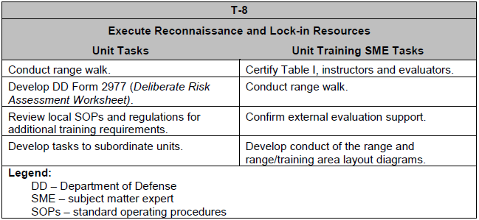
TASK WEEK
Notes:
T-8 focuses on range, facility, and training area reconnaissance to ensure they meet the training requirements for the planned event. Units include the entire staff into the reconnaissance effort and physically walk the terrain whenever possible. Units may have to coordinate with other units occupying the ranges or training areas planned to not disrupt their training.
Execute range and training area recon with key leadership and staff. This includes the identification of the primary functional areas on each range. This includes items such as the ammunition pad, medic location, Class I areas, maintenance areas, bivouac or billeting areas, AAR facilities, and the motor pool parking layout.
Unit should construct the DD Form 2977 (Deliberate Risk Assessment Worksheet) which will support each portion of the training event. This includes a review of the seasonal, live-fire, inclement weather, night operations, and extended training hour hazards.
Review the local SOPs and regulations for any additional requirements. This includes items such as ammunition detail requirements, emergency procedures, and range operations during severe weather.
The S-3 develops the tasks to subordinate units and specific instructions for the gunnery or live-fire event’s OPORD. The unit training SME provides any live-fire specific items for the OPORD, as necessary.
The unit training SME certifies the instructors and evaluators for the Table I period. Subordinate units should be prepared to support the Table I with their most experienced NCOs.
The unit training SME executes a range walk with the unit’s experienced NCOs and subordinate unit training SMEs to troubleshoot/war-game the live fire and tactical plans. The unit training SME provides any changes, updates, or modifications to the plan to the S-3, as necessary. The range walk includes reviewing the concurrent training plan, zeroing or screening procedures, conduct of the range, actions of the proofing team, and the execution of the Call-For engagement requirements.
Once the range walk is completed, the unit training SME develops a detailed conduct of the range briefing and updates the range safety briefing. The conduct of the range briefing includes the general scenarios, actions of the vehicles on the range, locations of key personnel and activities (medic support, for example), and the general flow from occupation of the range through range closure. The unit training SME presents this briefing to all crews and leadership executing training on the range or facility.

Slide 18
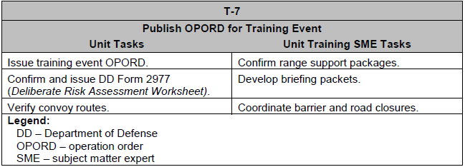
TASK WEEK
Notes:
During T-7, units issue the OPORD for the training event to the subordinate units and external support units. For training that requires an external evaluation, units should provide a copy to their headquarters for coordination.
The S-3 issues the training event OPORD. This includes all required annexes and enclosures.
The S-3 provides commanders within the unit a copy of DD Form 2977 for record. Commanders apply risk mitigation techniques and develop their daily risk assessments as required.
The unit S-4 confirms and verifies all convoy routes and clearances. The S-4 prepares updates for the following IPR as necessary.
The unit training SME confirms all range support package products. This includes the S-4 expendable items, targetry and associated thermalization and pyrotechnics with range operations, and any external evaluator support.
Most range facilities firing medium and large caliber munitions require barrier gate use and road closures. The unit training SME coordinates the barrier gate and road closure plan through range operations. The unit training SME provides the accurate barrier and closure locations to the barrier detail NCO tasked in the OPORD.
The unit training SME develops the briefing packets for each range or facility scheduled for use. This includes all packages for the briefing NCO, concurrent training NCO, and unit firing status tracking plans. The unit training SME must consider the communications flow during the conduct of the range to ensure timely updates to all briefing packets are completed.

Slide 19
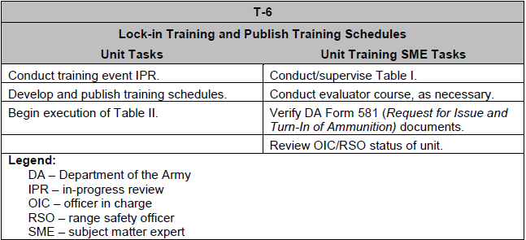
TASK WEEK
Notes:
Commanders develop their training schedules during T-6 in the Digital Training Management System to support the training event’s OPORD.
Unit begins conducting weekly IPRs to support the training event. Units should include a member from each staff element, the unit training SME, and subordinate unit leadership. Any critical changes identified during the IPR are recorded and implemented with supporting fragmentary orders (FRAGORDs).
Unit commanders should complete and submit all training schedules for the training period. Once approved, the commanders will input the schedules in the DTMS and publish. Commanders must include the appropriate firing uniform, including any personal protective equipment (PPE) required during live-fire use. Stabilized platform crews are required to wear complete fire resistant environmental ensemble (FREE) combat vehicle crewman (CVC) uniform, as required.
Units may begin executing Table II for record. Crews that have completed tables I, II, or III before T-6 must complete the exercise again to meet the live-fire prerequisites of the gate. There are no exceptions.
The unit training SME verifies all DA Form 581 (Request for Issue and Turn-In of Ammunition) information supporting the ammunition draw for the live-fire density. This includes any DA Form 581s that are created to support the draw and use of “in-lieu-of” ammunition types for use during high fire hazard periods.
The unit training SME should review the current list of certified RSOs and OICs within the unit. Units should strive to have all staff sergeants and above certified annually through range operations. For units firing on non-tenant installations, the unit training SME must coordinate for range safety certifications on the approved training installation.

Slide 20
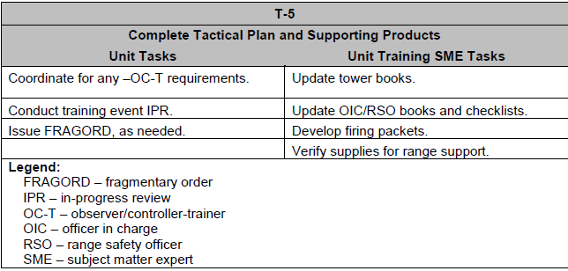
TASK WEEK
Notes:
If the training event includes a tactical or maneuver portion, the unit completes those plans during T-5. Units develop the evaluation packages required for any squad, crew, or collective training planned during the training event.
If any tactical training coincides with the live-fire training, complete the observer/controller–trainer (OC-T) plan. The unit must complete the master scenario events list (MSEL) supporting those collective tasks, as appropriate.
The unit continues to conduct IPRs on a weekly basis through training execution.
The unit training SME updates the tower books (sometimes termed “range book”), RSO and OIC books and checklists, and crew packets as necessary. Updates to the crew packets are completed weekly as live-fire prerequisite training and certifications are completed.
The unit training SME must verify all the range support items requested to support training. This includes any targetry that was scheduled for construction, shipment and delivery of targetry and pyrotechnics, and scenario builds within the range operating system.

Slide 21
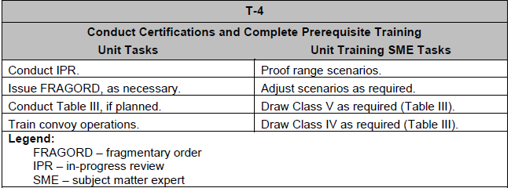
TASK WEEK
Notes:
The unit must ensure it has sufficient personnel certified to support the training event. This training takes a several weeks and should be monitored from T-4 through T-1. Certain training events have specific prerequisites that must be completed before any live-fire execution. The unit training SME updates the commander weekly on the progress of these requirements.
The unit may conduct Table III, Proficiency, in a decentralized manner. Table III can be conducted between T-6 and training execution, provided it is completed before any live-fire event, including any zero or screening exercise.
Units confirm their TACSOP and SOPs during convoy operations training. This training supports the driver’s training program within the unit. Units may choose to conduct convoy operations rehearsals at the completion of training, but it is not required.
The unit training SME selects a proofing team. This team must include experienced gunners and vehicle commanders. The proofing team executes two primary functions—
Provide troubleshooting support during zero, screening, or calibration procedures (live-fire).
Conduct proofing of each scenario on each training range.
The unit training SME or support element draws Class IV and V as appropriate to support Table III, if conducted separately from the live-fire training event. If the unit conducts Table III as part of the live-fire density, these items are drawn the week before the training event.

Slide 22
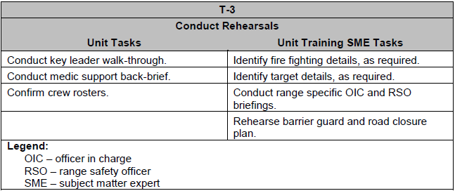
TASK WEEK
Notes:
The unit executes rehearsals of the training event including back briefs from key leaders and staff. Units should conduct a thorough rehearsal or rock drill of the entire training event to identify potential issues as early as possible, and provide sufficient reaction time to correct any deficiencies or shortcomings. The unit training SME continues to monitor live-fire prerequisite training and testing, and brief to the commander on the current status. (See table 2-11.)
The unit should conduct a key leader walk through as part of the weekly IPR. This walk through/terrain walk will provide leaders an opportunity to review the training plan on each range, training area, and facility. Units should pay particular attention to the communications and digital support plan, ammunition issue and turn-in procedures, billeting or bivouac locations, and conduct of the range procedures. The medic support element should include a back brief to the key leaders detailing all medic support at each training location, as well as sick-call procedures, MEDEVAC and CASEVAC plans, AXP, and Soldier Readiness Processing (SRP) capabilities. (When executing crew live-fire training, units should conduct other mandatory tasks; update shot records, initiate security clearances, initiate physicals, and so forth).
The unit must confirm the manning rosters and that all prerequisites have been met for all firing elements. Without appropriate personnel management and certifications, the unit significantly reduces its effectiveness and qualification status, increases the resource demands, and fails to meet training readiness and proficiency goals.
The unit training SME must identify and brief the cast of range support. This includes identification of the fire-fighting NCOs, targetry NCO, barrier NCO, and their supporting detail requirements. (The specific members of the details will not be identified until the firing day.)
The unit training SME briefs the planned and potential range safety officers and officers in charge, and provides any books and checklists they will need to execute during training. This provides them sufficient time to review their duties and responsibilities, as well as understanding the complexity of the training events they are directly supporting.
The barrier NCO and unit training SME must coordinate for a full rehearsal of the barrier gate and road closure plan. This rehearsal must be coordinated with range operations and must not negatively impact or interfere with units currently training. This rehearsal is critical to ensure communications connectivity can be established and maintained with all checkpoints. It provides accurate timing of the process to ensure the range is capable of receiving an opening hot time/day and night firing time. The rehearsal includes one or more iterations for the morning closure, as well as one or more for the night closure requirements.

Slide 23
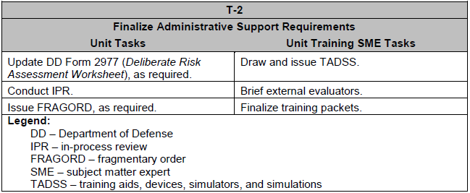
TASK WEEK
Notes:
Units collect all required administrative documentation for the training event during T-2. Unit training SMEs continue to monitor the progress of the live-fire prerequisite training and testing, and provide updates to the commander as necessary. (See table 2-12.)
Units update DD Form 2977 (Deliberate Risk Assessment Worksheet) as appropriate, based on expected weather hazards (S-2), training factors and complexity (S-3), or live-fire issues (unit training SME).
Units provide the updated DD Form 2977 during the IPR. Any supporting FRAGORDs supporting changes or alterations to the plan are provided.
The unit training SME and a supporting detail with sign for, draw and issue the supporting TADSS, as needed. Units must keep accurate accountability of the TADSS, particularly when using one system on multiple vehicles. The unit training SME must take the time to provide a method of maintaining accountability of the equipment.
The unit training SME conducts a briefing with the external evaluators tasked to support the live-fire training event. This meeting should include a conduct of the range briefing, AAR expectations, facility equipment that supports the AARs, current training guidelines, and an overview of the firing scenarios day and night. It is important for the unit training SME to record the contact information of all external evaluators, identify the day and night shift NCOICs, and provide range transportation coordination with the evaluation team.
The unit training SME finalizes all training packets used for the range. This includes sufficient blank documents for retraining and all live-fire prerequisite documentation, as needed.

Slide 24
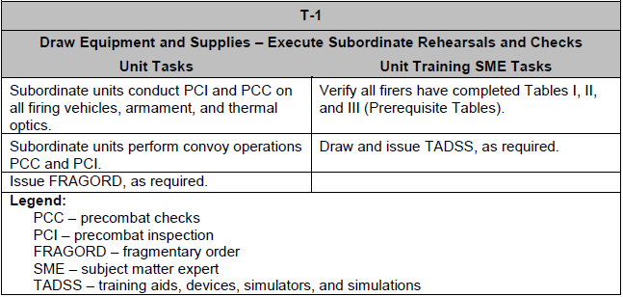
TASK WEEK
Notes:
T-1 focuses on preparing the unit to enter the training period with pre-combat inspections (PCI), pre-combat checks (PCC), convoy briefings, troop-leading procedures, and conducting support detail requirements. For units that are conducting Table III as part of their training event, they draw supporting TADSS and equipment from their training support center or range operations.
Subordinate units conduct PCI and PCC on all firing vehicles, armament, and thermal optics. Subordinate units will perform PCI and PCC for convoy operations supporting movement to the training locations. Units are expected to validate their tactical movement portion of their SOP or TACSOP, based on their method of movement to the training location.
The unit training SME assists the unit, as necessary, to achieve 100 percent successful completion of all Table I and Table II requirements for all crews and alternate firers, as appropriate. Any identified shortcomings require notification to the commander as well as a supportable training plan before firing. If Table III was completed before T-week, the unit must ensure that all requirements are met by all live-fire participants.
The unit training SME draws any remaining TADSS required to support the training plan. Coordination for routine troubleshooting and replacement of unserviceable components should be completed with the training support center.

Slide 25
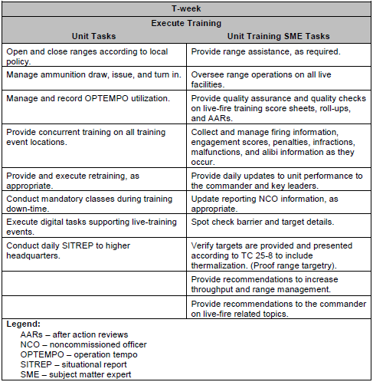
TASK WEEK
Notes:
T-week lasts for the duration of the training event. Units execute the training plan, re-training plan, and other tasks developed during the previous 21 weeks (12 months for RC). During execution, the unit training SME maintains the current training executed for each crew, maintains and monitors ammunition expenditures on each training facility, and provides quality assurance and quality checks on all live-fire related documentation. (See table 2-14.)
Open and close ranges according to installation’s range safety regulations and policies for each range, facility, and training area. The tower books provided by the unit training SME include all pertinent information to properly open and close the training locations.
Manage ammunition draw, issue, utilization, and turn-in. The unit’s support platoon manages the issue and turn-in of all ammunition daily. The unit training SME and range OIC will conduct inspections periodically throughout the training days. The OIC coordinates for gathering ammunition expenditures for day and night operations on each training location.
Manage and record OPTEMPO utilization for all combat platforms. The support platoon provides the OIC daily reports on Class III draw by quantity, bumper number (call sign), and type of petroleum, oil, and lubricants (POL) product.
Provide concurrent training on all training event locations that focus specifically on the training tasks for that range or training facility. Provide and execute retraining, as appropriate.
Conduct mandatory classes, Soldier readiness program (SRP) functions, security clearances, and so forth during live-fire training down-time.
The unit S-6 is the primary trainer and evaluator for all digital tasks. The S-6 reports the status of each completed vehicle by bumper number and task evaluated to the unit training SME and OIC.
The unit training SME is responsible to oversee range operations on all live facilities. Further, he provides quality assurance and quality checks on live-fire training score sheets, roll-ups, and AARs.
The range NCO is the primary point of live-fire results collection and mange crew firing information, engagement scores, crew penalties, infractions, malfunctions, and alibi information as they occur. The range NCO promptly disseminates the information to the reporting NCO, unit training SME, and range OIC. The unit training SME and range NCO provide daily updates on crew performance to the commander and key leaders.
The unit training SME verifies targets are provided and presented according to TC 25-8 to include thermalization and hostile fire simulators. The unit training SME will coordinate with the range operations personnel for any targetry deficiencies found on the range. If the unit training SME identifies any target that is not presented to the Army standard on the qualification range, that target presentation may not be used until it is corrected. This includes targetry that is not thermalized or that does not provide the hostile fire simulation/battle effects simulator to the Army standard.
The unit training SME provides recommendations to increase range throughput and management. Recommendations on all live-fire-related topics are provided to the commander.

Slide 26
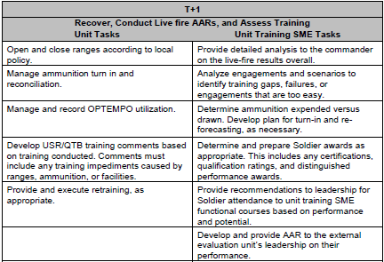
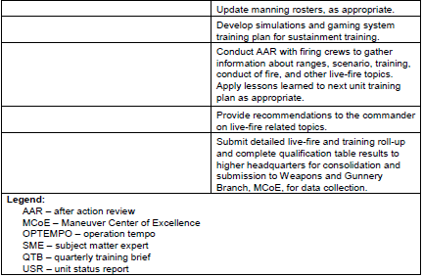
TASK WEEK
Notes:
T+1 provides the initial tasks of recovering from training operations. It represents the first steps in analyzing training records from the event to develop future training requirements. Units are required to provide their live-fire results in roll-up format, as well as common crew score sheets to the next higher headquarters for review and analysis.
The analysis of the live-fire training event is the critical to the unit’s success. It provides detailed analysis to the commander on the live-fire results by crew, section, platoon, and unit. The unit training SME must analyze the engagements and scenarios to identify training gaps, failure, or engagements that are too easy or too demanding.
During the analysis, the unit training SME must determine the ammunition expended versus drawn, develop a plan for turn-in and re-forecasting the ammunition as necessary. This analysis is the first step in planning the next live-fire training event. Unit closes out any active or open DA Form 581 as required. Unit must reconcile all ammunition expenditures and ensure all remaining live ammunition and dunnage are turned in as per regulation and unit or installation policy.
The analysis identifies excellence within the unit. The unit training SME assists the unit leadership to determine and prepare awards for certifications, qualifications, or exceptional performance, as appropriate. The analysis will indicate exceptional performers for recommendations to leadership for Soldier attendance to unit training SME functional courses.
The unit must update manning rosters, as appropriate. The unit training SME assists in preparation of unit status reports regarding weapon and weapon system qualifications.
The unit training SME develops simulations and gaming system training plan for qualified (experienced) elements for sustainment training. These units continue training within the simulations or gaming systems to achieve the next higher level of proficiency within the system’s instructional database or unit developed training scenarios, respectively.
The unit should conduct an AAR with firing units to gather information about ranges, scenarios, preparatory training, conduct of fire, and other live-fire topics. Apply lessons learned to the next training event planning process.
The unit training SME submits a detailed live-fire and training event roll-up and complete qualification table results to the higher headquarters.

Slide 27
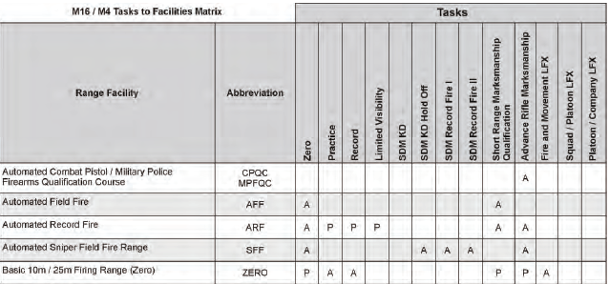
Training Ranges TC 25-8
Appendix A: M16/ M4 Range Matrix
Notes:
The following table represents the individual training requirements for the M4 and M16 series weapons and the appropriate ranges capable of meeting the training event’s specific requirements.
Primary Capability, Listed as “P” on the tables, indicates a primary capability of a range to conduct the specified STRAC resourced requirement. The range identified is specifically designed to accommodate the task.
Alternate Capability, Listed as “A” on the tables, indicates an alternate capability of the range.

Slide 28
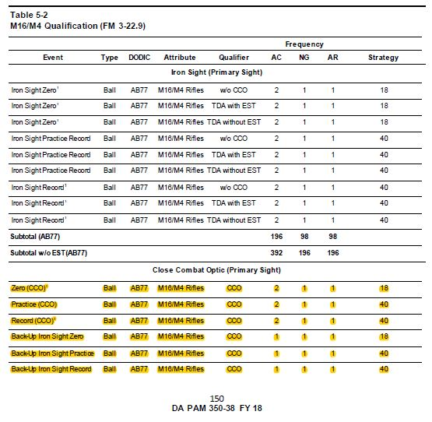
Standards in Weapons Training DA PAM 350-38
Notes:
Formerly known as Standards in Training Commission (STRAC)
Weapons and equipment are resourced ammunition, not individual Soldiers.
Each individual piece of equipment is authorized ammunition to train semi-annually for AC, annually for RC.
Table 5-2, beginning on page 150 of DA PAM 350-38, shows the authorizations and their frequency for all rifles and carbines, and their associated equipment, for an Infantry unit.
The ammo authorizations described on the successive slides is for individual training and qualification, prior to the conduct of any live-fire training event.
Here we see the ammunition authorization for the CCO and the BUIS, highlighted in yellow
Consider this example:
Two Soldiers, one Active and one in the National Guard. Both are Infantry, assigned to a unit that is deployed to an austere environment with no access to an EST or comparable simulator, and both are assigned the following:
M4A1 Carbine
M68 CCO
BUIS
AN/PEQ-15

Slide 29
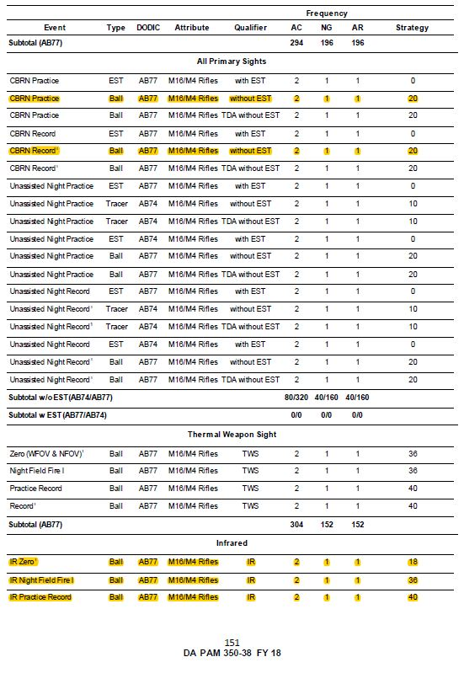
Standards in Weapons Training
DA PAM 350-38
Notes:
Because the Soldiers do not have access to a simulator, they are authorized ammunition to conduct a live CBRN CoF. On this page we also see the ammunition authorization for the AN/PEQ-15 for zeroing, night field fire, and for practice.

Slide 30
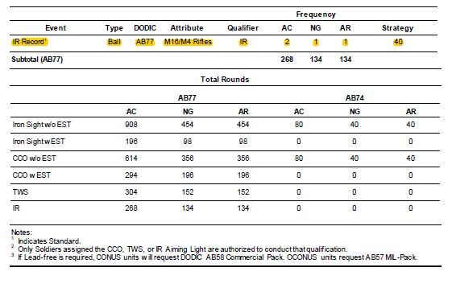
Standards in Weapons Training DA PAM 350-38
Notes:
And on the final page, we see the ammunition authorization for IR record fire.

Slide 31
Standards in Weapons Training DA PAM 350-38
Ammunition Authorization
Equipment | Event |  |  | Totals
 | Zeroing | Practice | Record
BUIS | 18 | 40 | 40 | 98
M68 | 18 | 40 | 40 | 98
AN/PEQ-15 | 18 | NFF - 36 / Practice - 40 | 40 | 134
M4A1 w/out EST (CBRN) | N/A | 20 | 20 | 40
Legend: NFF – Night Field Fire. NOTE: This table depicts a frequency of one for the purposes of ammunition authorization. |  |  |  | 370
Notes:
Ammunition is ordered by firing event. The only requirement a commander has to report is a qualification for this Soldier once annually. The commander determines which sighting device the Soldier qualifies with.
When ordering ammunition (called forecasting), order by equipment for each event and you’ll get all the ammunition you could hope for, providing it falls within this DA PAM.

Slide 32
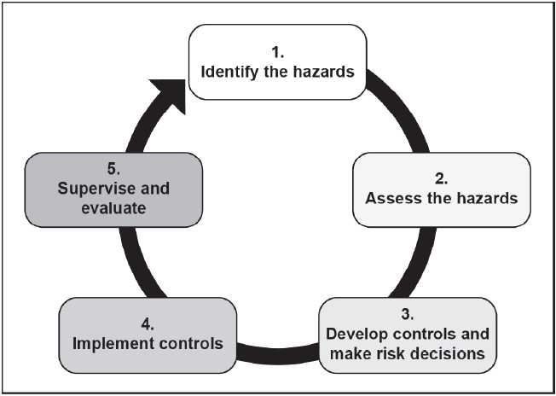
Risk Management ATP 5-19
Notes:
Risk management is the process of identifying, assessing, and controlling risks arising from operational factors and making decisions that balance risk cost with mission benefits (JP 3-0). The Army uses risk management (RM) to help maintain combat power while ensuring mission accomplishment in current and future operations. RM applies to operations and to nonoperational activities.

Slide 33
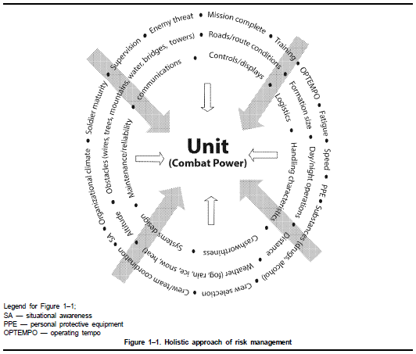
Risk Management ATP 5-19
Notes:
Unidentified and unmanaged hazards and their associated risks impede successful Army missions, undermine readiness, decrease morale, and deplete resources. The holistic approach of risk management provides commanders a tool to recognize, evaluate, eliminate, and control the diverse threats and risks to mission execution. The underlying philosophy of risk management is that a loss is a loss. The loss can be any one of the following:
(1) Tactical (threat-based) loss.
(2) Accidental (hazard-based) loss.
(3) Loss due to terrorism, suicide, homicide, illness, or substance abuse.
b. Any event that threatens combat readiness and the ability to project power can and should be considered a risk
factor.

Slide 34
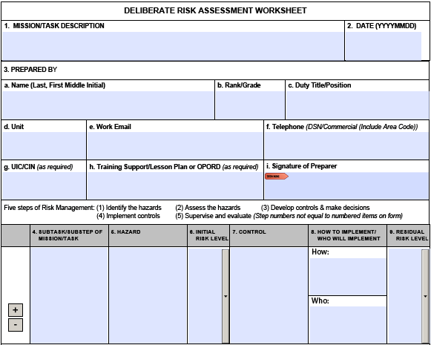
Deliberate Risk Assessment Worksheet DD Form 2977
Notes:
Mission/Task Description: Briefly describe the overall Mission or Task for which the deliberate risk assessment is being conducted.
2. Date (DD/MM/YYY): Self Explanatory.
3. Prepared By: Information provided by the individual conducting the deliberate risk assessment for the operation or training. Legend: UIC = Unit Identification Code; CIN = Course ID Number; OPORD = operation order; DSN = defense switched network; COMM = commercial
4. Sub-task/Sub-Step of Mission/Task: Briefly describe all subtasks or substeps that warrant risk management.
5. Hazard: Specify hazards related to the subtask in block 4.
6. Initial Risk Level: Determine probability and severity. Using the risk assessment matrix (page 3), determine level of risk for each hazard specified. probability, severity and associated Risk Level; enter level into column.
7. Control: Enter risk mitigation resources/ controls identified to abate or reduce risk relevant to the hazard identified in block 5.
8. How to Implement / Who Will Implement: Briefly describe the means of employment for each control (i.e., OPORD, briefing, rehearsal) and the name of the individual unit or office that has primary responsibility for control implementation.
9. Residual Risk Level: After controls are implemented, determine resulting probability, severity, and residual risk level.

Slide 35
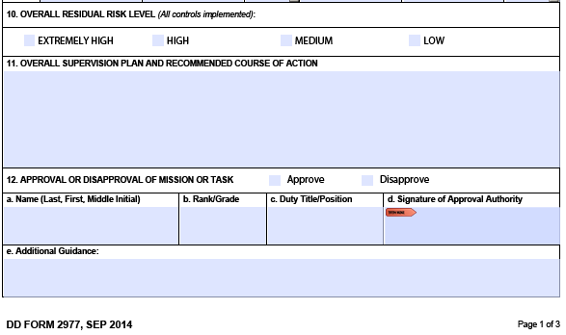
Deliberate Risk Assessment Worksheet DD Form 2977
Notes:
10. Overall Risk After Controls are Implemented: Assign an overall residual risk level. This is equal to or greater than the highest residual risk level (from block 9).
11. Supervision Plan and Recommended Course of Action: Completed by preparer. Identify specific tasks and levels of responsibility for supervisory personnel and provide the decision authority with a recommend course of action for approval or disapproval based upon the overall risk assessment.
12. Approval/Disapproval of Mission/Task: Risk approval authority approves or disapproves the mission or task based on the overall risk assessment, including controls, residual risk level, and supervision plan.

Slide 36
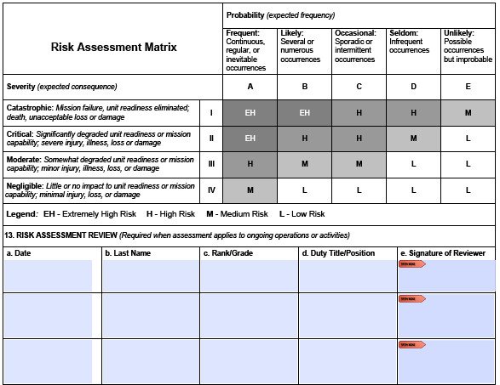
Deliberate Risk Assessment Worksheet DD Form 2977
Notes:
13. Risk Assessment Review: Should be conducted on a regular basis. Reviewers should have sufficient oversight of the mission or activity and controls to provide valid input on changes or adjustments needed. If the residual risk rises above the level already approved, operations should cease until the appropriate approval authority is contacted and approves continued operations.

Slide 37
Deliberate Risk Assessment Worksheet DD Form 2977
Notes:
14. Feedback and Lessons Learned: Provide specific input on the effectiveness of risk controls and their contribution to mission success or failure. Include recommendations for new or revised controls, practicable solutions, or alternate actions. Submit and brief valid lessons learned as necessary to persons affected.
15. Additional Comments or Remarks: Preparer or approval authority provides any additional comments, remarks, or information to support the integration of risk management.
Additional Guidance: Blocks 4-9 may be reproduced as necessary for processing of all subtasks/ substeps of the mission/task. The addition and subtraction buttons are designed to enable users to accomplish this task.

Slide 38
Target Visibility
Target Exposure and Visibility Memorandum 03AUG15
Notes:
Bottom Line: Targets are not presented to the Army standard as defined in TC 25-8, Training Ranges, and FM 3-22.9, Rifle Marksmanship, on any Automated Record Fire (ARF) and Modified Record Fire (MRF) range within the Army. Further, targets on these facilities blend in to the surrounding environment at extended ranges, resulting in negative training value and impeding firing unit throughput. These issues have stalled the development of an improved Rifle Marksmanship training strategy.
864 targets tested, only one target was exposed to the firer to the Army standard of 90% visibility. The root cause of the visibility issue is believed to be the construction method of each emplacement, coupled with the range design’s placement of the lifting mechanism below grade. This reduces the amount of the target presented to the firer from 4 inches to as much as 12 inches, regardless of the location or target type.

Slide 39
Target Visibility
Target Exposure and Visibility Memorandum 03AUG15
Figure 1, Probability of Hit (ph) by distance, AUG 2013 Pilot Research, ARI
Notes:
Number of rounds for zeroing: Evaluate the change in qualification performance based on the use of 3-round shot groups versus 5-round shot groups for grouping / zeroing. Identifying which shot group size provided a consistently greater probability of qualification would therefore provide ammunition savings for use within a marksmanship training strategy for specific Military Occupational Specialty firers (11 series, 19D, and 12B).
Suitability of LOMAH and TRACR technologies: Modified Record Fire (MRF) ranges on IET installations have both the Army’s Targetry Range Automated Control and Recording (TRACR) software suite and LOMAH (Location of Miss and Hit) on targets at 75m, 175m, and 300m. The test was expected to identify potential increase in range throughput, and ammunition savings through increased accuracy of grouping and zeroing.
Confirming zero at distance with LOMAH versus using 25m paper targets. The test was to evaluate the standard zeroing practice using 25m paper targets as compared to downrange confirmation using LOMAH at 175m (at distance) to achieve a 300m zero.
Suitability of 200M vs.300M zero. Based on feedback from leaders attending OES or NCOES courses, this test is to determine the best practices on zeroing procedures and techniques for inclusion into the rifle marksmanship training circular. This information was to provide detailed statistical information to commanders to determine the appropriate method of zero based on their expected area of operations.

Slide 40
Target Visibility
Target Exposure and Visibility Memorandum 03AUG15
Figure 4, Oscar 7 Target Visibility Assessment
Notes:
Talk target exposure on this 16 Lane ARF and how no targets met exposure standard

Slide 41
Target Visibility
Target Exposure and Visibility Memorandum 03AUG15
Figure 10, Identify the height increase required for each emplacement individually
Figure 11, Extended E-type example
Notes:
Step 1: Identify the required height increase of each target emplacement. This should be measured from the bottom of the target lifting mechanism’s mounting bracket when in the upright position to the bottom of the target that can be seen completely by a firer in the prone position for the respective lane. This measurement should be recorded for each target emplacement in order to reduce maintenance time during target replacement.
. Step 2: Invest in taller E- and F-type targets. These targets are $39.60 each, approximately four times the cost of the existing targets. These targets are available on GSA catalog or direct from the manufacturer. The E-type silhouette is 54” tall, with the F-type 44” tall. They are specifically designed with thicker plastic polymer for rigidity in order to eliminate systemic bending during high heat environments. These targets are trimmed to custom heights for each emplacement in order to eliminate any safety concerns with attaching hardware. This will also lower sustainment range maintenance time. Total approximate cost for one range (144 targets) is $5750, depending on the vendor, availability, shipping, and lead time.
. Step 3: Use alternating and contrasting colors by lane. To reduce the target acquisition issues at extended ranges and periodic cross lane engagements, contrasting color targets should be selected. Colors selected must not interfere with the standard reticle patters or markings for and day optic used during training (ACOG or CCO). For example, even lanes should use yellow targets and odd lanes use orange targets.
Step 4: Provide information to TCM-Ranges. Make near-term recommendations to TCM-Ranges with directions for calibrating the targets, measurement techniques, target jig construction for rapid target creation, etc.
Step 5: Request Army funding for target replacement. MCoE DPTMS and Range Operations should request additional funding for corrective targetry solutions until the Army’s long-term material solution is provided. Priority should go to MCoE ranges that specifically train grouping and zeroing or are used for rifle /carbine qualification.

Slide 42
QUESTIONS?

