Slide 1
“To strengthen the emphasis on implementing physical readiness training doctrine Army-wide, TRADOC will transition TC 3-22.20 to Field Manual 7-22, Army Physical Readiness Training, and Master Fitness Trainers will train units on the doctrine in [FM 7-22] in order to reduce injuries and improve Soldier performance. [FM 7-22] focuses unit training on developing Soldier physical readiness required to perform Warrior Tasks and Battle Drills.”
www.army.mil; "Odierno discusses Master Fitness training, new doctrine during TRADOC visit"; August 7, 2012
Notes:
General Odierno, TRADOC Commander recognized the importance and impact of PRT doctrine and the MFTC has on Soldier physical performance and injury control. Changing the TC back to an FM helps to increase the significance of PRT doctrine as an essential element to Army combat readiness.

Slide 2
Terminal Learning Objective
Action: | Identify the Army Physical Readiness Training Philosophy.
Conditions: | In a large group classroom, given a FM 7-22, Army Physical Readiness Training, the Basic Combat Training (BCT) Program of Instruction (POI), and Course Management Plan (CMP), and uniform as designated by unit leadership.
Standards: | Understand Army PRT Philosophy and its relationship to the Army's mission as described in FM 7-22, Chapter 1.
Notes:
During this period of instruction we will identify and discuss the philosophy of PRT, or rather the “WHY” behind the development of this training doctrine.

Slide 3
Physical Readiness Training Philosophy

Slide 4
Army Regulations and Doctrine in Support of PRT
AR 350-1: Army Training and
Leader Development
ADP & Training Units and
ADRP 7-0: Developing Leaders
FM 7-22: Army Physical Readiness Training
Notes:
In order for PRT to be implemented successfully, it must follow and align with the Army regulations and policy directives that govern it. Applying the training principles and guidance found in AR 350-1 and ADP/ADRP 7-0, aligns PRT with all other Army training and doctrine.

Slide 5
Principles of Army Training
1 | Commanders and Other Leaders are Responsible for Training.
2 | Noncommissioned Officers Train Individuals, Crews, and Small Teams
3 | Train to Standard
4 | Train as You Will Fight
5 | Train while Operating
6 | Train Fundamentals First
7 | Train to Develop Adaptability
8 | Understand the Operational Environment
9 | Train to Sustain
10 | Train to Maintain
11 | Conduct Multiechelon and Concurrent Training
Reference: ADP 7-0, Table 1-1, page 5
Notes:
These are the principles that all Army training should follow. We will look at each and discuss how they apply to PRT.

Slide 6
Commanders and Other Leaders are Responsible for Training
As the unit’s primary training manager, commanders must do the following to optimize the effect of PRT:
Incorporate mission command in PRT.
Supervise the planning, preparation, execution and assessment of PRT.
Align PRT with mission/METL requirements in support of unified land operations.
Train to standard IAW FM 7-22.
Assess individual and unit physical readiness IAW FM 7-22.
Provide resources required to execute PRT.
Incorporate safety and Composite Risk Management (CRM).
Ensure training is realistic and performance-oriented.
Ensure training replicates the operational environment as closely as possible.
Notes:
PRT is the Commanders program.

Slide 7
Noncommissioned Officers Train Individuals, Crews and Small Teams
To accomplish the PRT mission, NCOs:
Identify specific tasks that PRT enhances in support of the unit’s METL.
“Mastery of the key collective tasks and the supporting
individual tasks prepares Soldiers, leaders, and units
to adapt to changes in missions and conditions.” ADP 7-0
Prepare, rehearse and execute PRT.
Evaluate PRT and conduct AARs to provide feedback to the commander.
Senior NCOs train junior NCOs and aid in developing junior officers, ensuring mastery of PRT drills, exercise activities and assessments.
Notes:
Commanders own the program - NCOs execute the program.

Slide 8
Train to Standard
Standards-based training is:
Leaders know and enforce standards.
Leaders define success in the absence of standards.
Leaders train to standard, not time.
Standards are achieved through precise control of the following:
Prescribe appropriate intensity and duration that Soldiers perform PRT.
Properly distribute external loads across the major joints of the body.
Integrate and balance of the components of strength, endurance and mobility.
Provide adequate rest, recovery and nutrition.
Notes:
We are a standards-based Army and PRT is a standardized program. The three principles of PRT: Precision, Progression and Integration provide the framework for standardization to occur.

Slide 9
Train as You Will Fight
“Train as You Will Fight”, as it relates to PRT:
PRT must support unified land operations and promote quick transitions between missions.
PRT must support proficiency in combined arms operations and unified actions.
PRT focus is on training the fundamentals first.
Ensure PRT is performance-oriented, conducted under realistic conditions and mission focused.
PRT should incorporate challenging, complex, ambiguous and uncomfortable situations.
Incorporate safety and composite risk management (CRM).
Conduct PRT under conditions that replicate the operational environment.
Conduct PRT while deployed.
Notes:
Following this principle is very important to the success of PRT at unit level. The specific emphasis on training the components of Strength, Endurance and Mobility will vary just as unit missions and METLs vary. Commanders will adjust training to be appropriate to the unit.

Slide 10
Train While Operating
PRT continues when units are deployed.
As units operate, they learn from formal and informal after action reviews.
Units train to improve performance.
Initial Conditioning Phase
Toughening Phase
Sustaining
Reconditioning
Notes:
Time is an important asset of PRT. OPTEMPO varies from unit to unit and is usually intensified when deployed.
Wherever you are in the unit training cycle, PRT should be appropriately applied to safely improve performance.

Slide 11
Train Fundamentals First
Units at every echelon must master the fundamentals needed to accomplish their mission.
Fundamentals include basic soldiering, the Warrior Tasks, Battle Drills, marksmanship, fitness, and military occupational specialty proficiencies that support the capabilities of the unit.
Units proficient in fundamentals are more capable of
accomplishing higher level, more complex collective tasks that support the unit’s mission-essential task list—the fundamental, doctrinal tasks that units should be prepared to execute during any assigned mission.
Notes:
WTBDs, marksmanship, fitness and job proficiency are all fundamental to mission success.

Slide 12
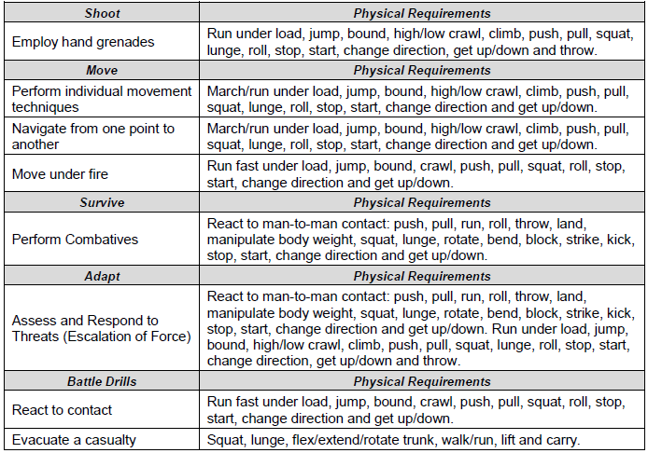
Train Fundamentals First
Warrior Tasks and Battle Drills, Physical Requirements for Performance
Reference: FM 7-22, Table 1-2, page 1-4

Slide 13
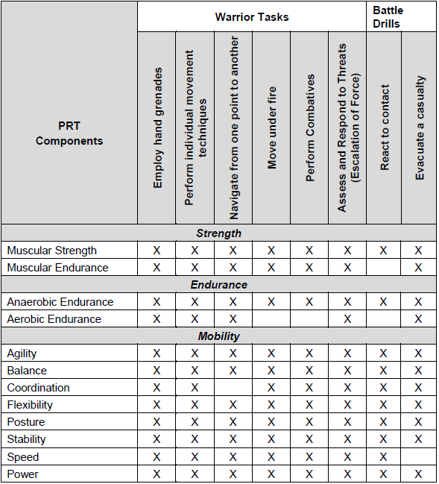
Train Fundamentals First (continued)
Warrior Tasks and Battle Drills, Physical Requirements for Performance
Reference: FM 7-22, Table 1-3, page 1-5
Notes:
This slide depicts relationship of PRT components necessary to the physical accomplishment of WTBDs.

Slide 14
Train Fundamentals First (continued)
Warrior Tasks and Battle Drills, Physical Requirements for Performance
PRT Activities | Warrior Tasks |  |  |  |  |  | Battle Drills
 | Employ hand grenades | Perform individual movement techniques | Navigate from one point to another | Move under fire | Perform Combatives | Assess and Respond to Threats (Escalation of Force) | React to contact | Evacuate a casualty
Conditioning Drill 1 | X | X | X | X | X | X | X | X
Conditioning Drill 2 | X | X | X | X | X | X | X | X
Conditioning Drill 3 | X | X | X | X | X | X | X | X
Guerrilla Drill | X | X | X | X | X | X | X | X
Climbing Drill1 | X | X | X | X | X | X |  | X
Climbing Drill 2 | X | X | X | X | X | X |  | X
Strength Training Circuit | X | X | X | X | X | X | X | X
Military Movement Drill 1 | X | X | X | X | X | X | X | X
Military Movement Drill 2 | X | X | X | X | X | X | X | X
30:60s |  | X | X | X | X | X | X | X
60:120s |  | X | X | X | X | X | X | X
300-yd Shuttle Run | X | X | X | X | X | X | X | X
Ability Group Run |  | X | X
Unit Formation Run |  | X | X
Release Run |  | X | X | X | X | X | X | X
Terrain Run | X | X | X | X | X | X | X | X
Hill Repeats | X | X | X | X | X | X | X | X
Foot Marching |  | X | X | X |  |  |  | X
Obstacle Course Negotiation | X | X | X | X | X | X | X | X
Combatives | X | X | X | X | X | X | X | X
Reference: FM 7-22, Table 1-4, page 1-6
Notes:
This slide depicts relationship of PRT drills, exercises and activities to the physical accomplishment of WTBDs.

Slide 15
Leaders Train to Develop Adaptability
“Effective leaders understand that change is inevitable in any operational environment.” ADP 7-0
Developing the ability of Soldiers to meet the changing physical demands that are placed upon them without undue fatigue or risk of injury is woven into the fabric of the PRT System.
PRT gives personnel the confidence that all Soldiers in the unit have similar physical capabilities and the mental and physical discipline needed to adapt to changing situations
and physical conditions.
Notes:
The ability to adapt to any and all situations is key to success on the battlefield.

Slide 16
Understand the Operational Environment
“An operational environment establishes the conditions for training. The conditions are drawn from the operational variables—known as PMESII-PT—that must be replicated to prepare the unit for operations. The unit training management operation order establishes the conditions that units must meet for training.”
ADP 7-0
WHAT’S THE LINK?
CDR
MFT
WTBD
Operational
Environment
PRT
Notes:
PMESII-PT = Political, Military, Economic, Social, Infrastructure, Information, Physical Environment, and Time (US Army)

Slide 17
Train to Sustain
Units must be able to operate continuously while deployed.
PRT provides a foundation for combat readiness and must be an integral part of every Soldier’s life.
Units need to be capable of fighting for sustained periods.
The link between training and sustainment is vital to mission success.
Sustainment training is key to maintaining unit proficiency despite personnel turbulence and operational deployments.
Notes:
Once Soldiers/units attain a desired level of physical readiness, they must continually train to sustain it.

Slide 18
Conduct Multiechelon and Concurrent Training
All multi-echelon training techniques have these distinct characteristics:
Requires detailed planning and coordination by commanders and leaders at each echelon.
Maintains battle focus by linking individual and collective battle tasks with unit METL tasks and within large-scale training event METL tasks.
Habitually train at least two echelons simultaneously on selected METL tasks and require maximum use of allocated resources and available time.
Concurrent training is when two types of training are conducted simultaneously for efficient use of time.
Part of the unit performs climbing drills while the rest of the
unit performs conditioning drills.
Notes:
Coordinating unit PRT is like conducting an orchestra. Bring together the sounds of many different instruments to create music takes practice and planning. Unit PRT is conducted much in the same way through multiechelon and concurrent training.

Slide 19
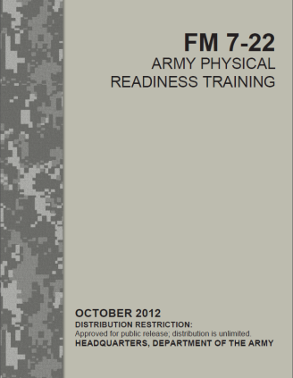
Army PRT System and Relationship to ARFORGEN
Notes:
This slide depicts the PRT System from the time an individual is recruited through retirement.
Note that at any time, a Soldier may need reconditioning to heal/recover and build back up after injury, illness or other medical condition.
The cycles within Army Force Generation (ARFORGEN) address how units train to deploy. The intensity and duration of PRT is adjusted to best fit each cycle.
We will discuss the details of each element of this slide during the PRT System class.

Slide 20
Check on Learning
QUESTION: List 4 of the 11 Principles of Training.
QUESTION: What 2 principles of training is “FITNESS” woven into?
QUESTION: What is the link between the Operational Environment and PRT?
QUESTION: _______(fill in the blank)_______ plan training in detail, prepare for training thoroughly, execute training to standard and evaluate long-term training proficiency in terms of desired long-term results.
Notes:
QUESTION: List 4 of the Principles of Training.
ANSWER: (ADRP 7-0, paragraph 2-1, page 2-1)
Commanders and other leaders are responsible for training.
Noncommissioned officers train individuals, crews, and small teams.
Train to standard.
Train as you will fight.
Train while operating.
Train fundamentals first.
Train to develop adaptability.
Understand the operational environment.
Train to sustain.
Train to maintain.
Conduct multi-echelon and concurrent training
QUESTION: What 2 principles of training is fitness woven into?
ANSWER: Except for “Train to Maintain”. All of them. However, fitness is specifically mentioned in:
a. Train Fundaments First (ADRP 7-0, paragraph 2-9, page 2-2)
b. Train to Sustain, (ADRP 7-0, paragraph 2-12, page 2-3)
QUESTION: What is the link between the Operational Environment and PRT?
ANSWER: The Commander, The Master Fitness Trainer, and Warrior Tasks and Battle Drills (slide 17)
QUESTION: _(fill in the blank)___________ plan training in detail, prepare for training thoroughly, execute training to standard and evaluate long-term training proficiency in terms of desired long-term results
ANSWER: Commanders (FM 7-22, paragraph 1-27, page 1-9)

Slide 21
Summary
FM 7-22 IS the Army’s PRT doctrine provides Soldiers and Leaders with the doctrine of Army Physical Readiness Training. It is a product of our history, forged out of the great battles from the past to the present. Its doctrinal concepts also reflect emerging trends in current physical culture.
PRT doctrine follows the guidelines and policies established in ADP 7-0, AR 350-1 and TRADOC Reg 350-6.
The purpose of Army PRT is not merely to make our Soldiers look fit, but to actually make them physically ready for the conduct of unified land operations.

Slide 22
“Military physical training should build Soldiers up physically, wake Soldiers up mentally, fill Soldiers with enthusiasm and discipline them.”
Koehler’s West Point Manual of Disciplinary Physical Training (1919)
Notes:
LTC Herman Koehler was the Instructor of Military Gymnastics and Physical Culture at the United States Military Academy (West Point) 1885-1923.

