Slide 1
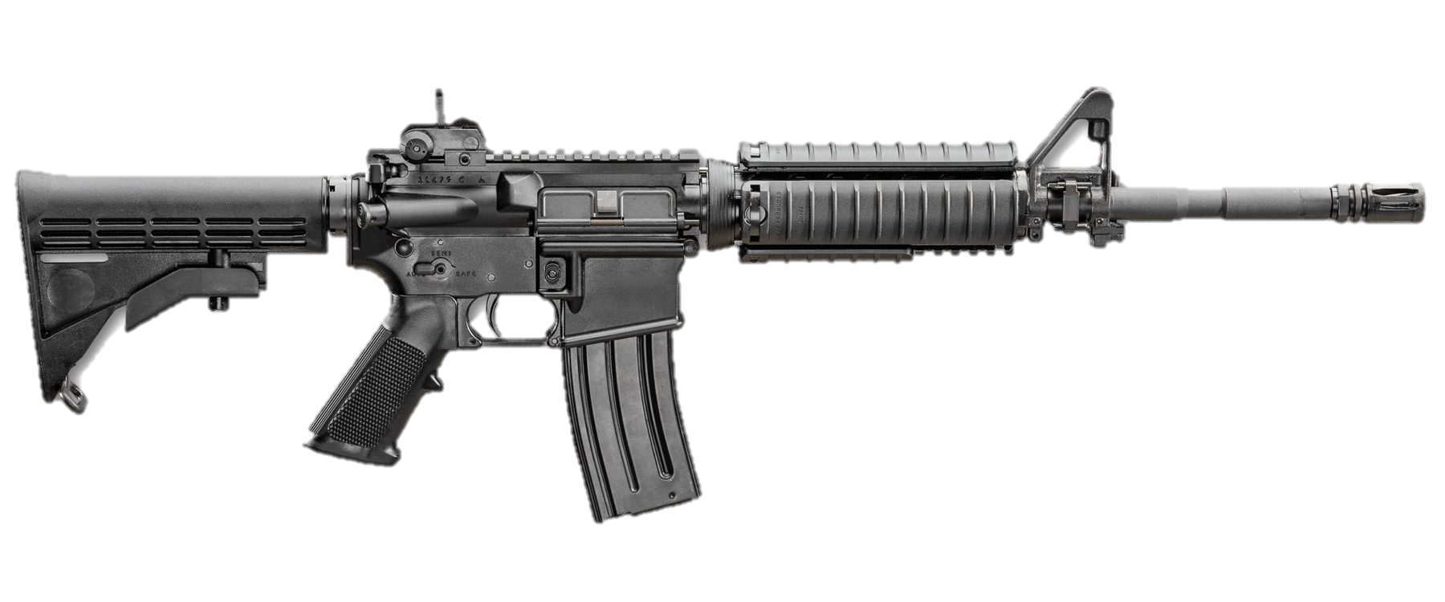
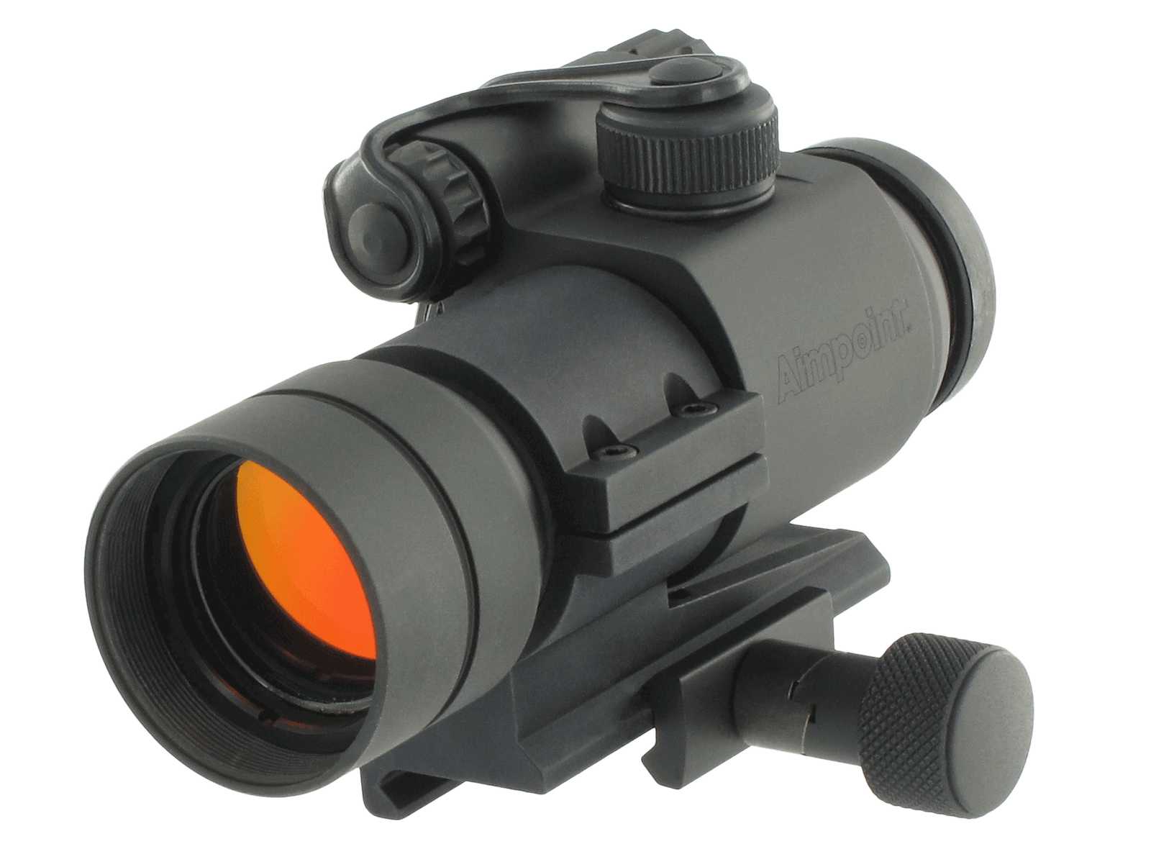
Weapons Cleaning And Maintenance
M150 RCO
M68 CCO

Slide 2
Why is it a good idea to make sure your weapon works for Qualification?

Slide 3
What if I have a Malfunction during Qual?
Weapon Needs Replacement/ Repair?
Weapons Malfunction?
Immediate Action
Fixed?
Remedial Action
Fixed?
Yes
No
No
No
Yes
Yes
Yes
No
Continue Firing
OIC Grants Refire
Soldier accepts score. Potential Qual Failure.
It is critical the soldier understands the importance of maintaining their weapon, magazine, and other equipment to the highest standard. – TC 3-20.0 Para 4-87

Slide 4
Non-Mission Capable (NMC) Weapon – Determined by OIC directed inspection. Verified fault according to Technical Manual. Not due to fault of the Soldier. Requires armor support or higher.
If Soldier requires new weapon, they must group, zero, and confirm at distance before re-attempting qualification.

Slide 5
Weapon Malfunctions
Notes:
Most common malfunctions are shooter induced. SPORTS will clear most shooter induced malfunctions
Failure to extract is cleared by mortaring the weapon or slamming the stock on the ground or your knee
Failure to eject is prevented by good weapon cleaning practices.

Slide 6
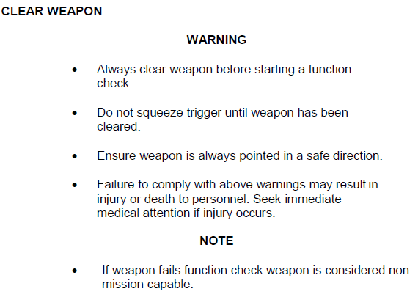
Clear Weapon

Slide 7
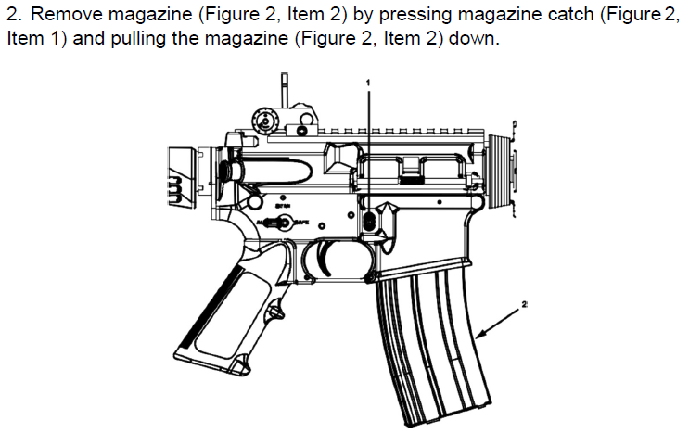
Clear Weapon

Slide 8
Clear Weapon

Slide 9
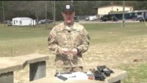
Weapon Maintenance

Slide 10
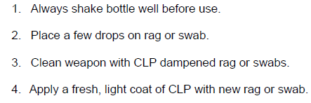
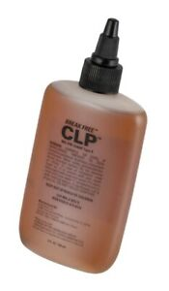
CLP
Cleaner, Lubricant, and Preservative

Slide 11
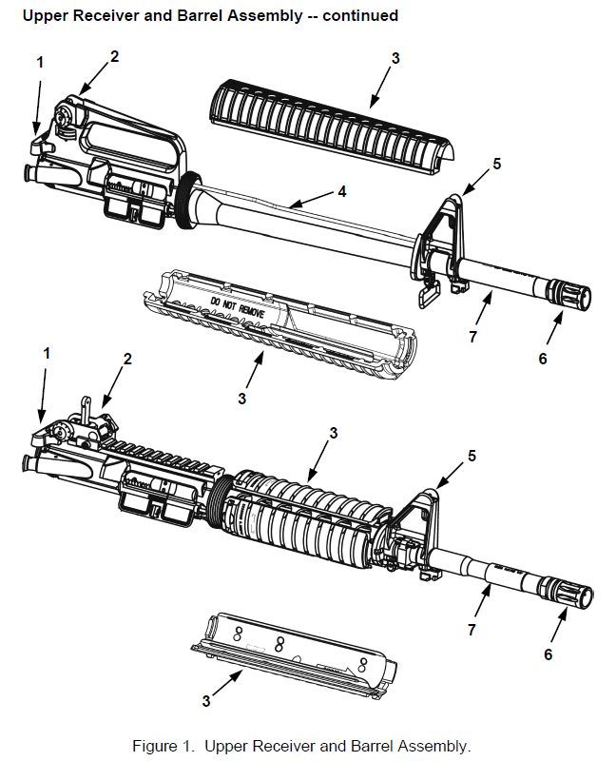
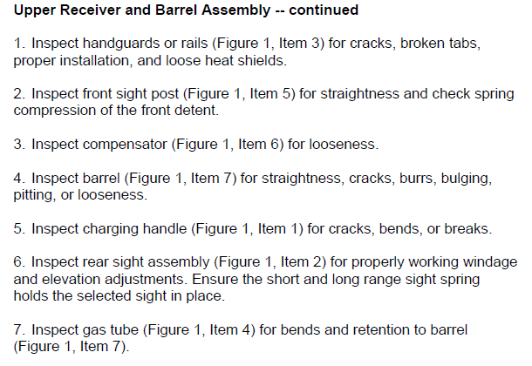
Inspect:
Upper Receiver and Barrel Assembly

Slide 12
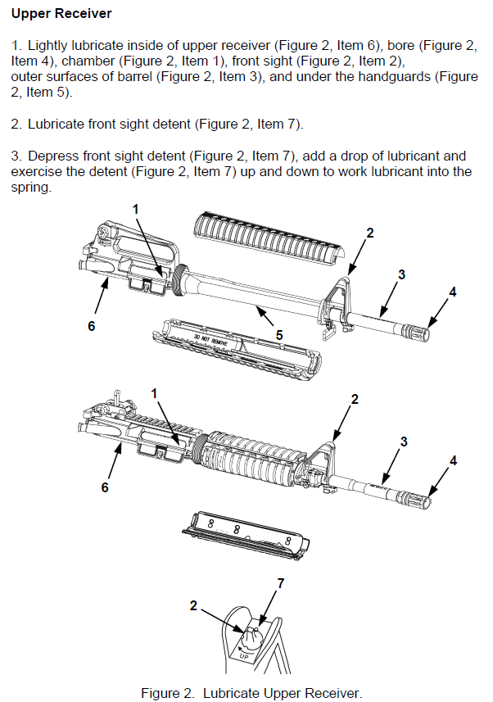
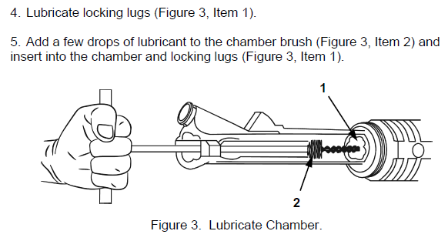
Maintain:
Upper Receiver

Slide 13
Maintain:
Upper Receiver

Slide 14
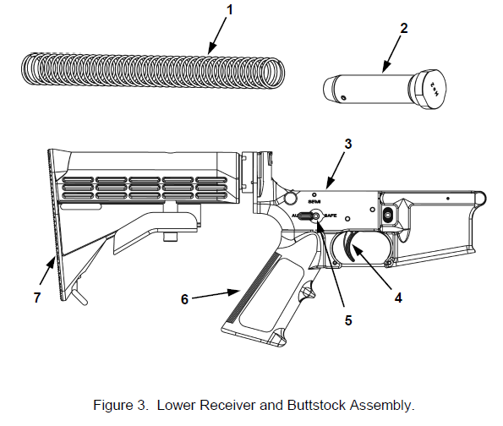
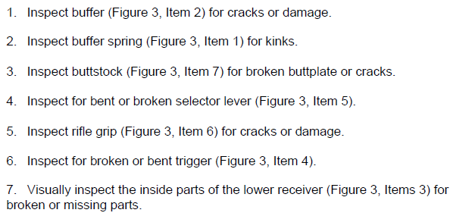
Inspect:
Lower Receiver and Buttstock Assembly

Slide 15
Maintain:
Lower Receiver Assembly

Slide 16
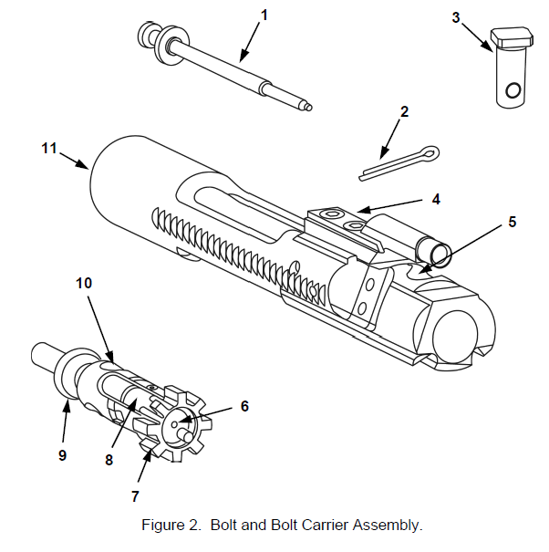
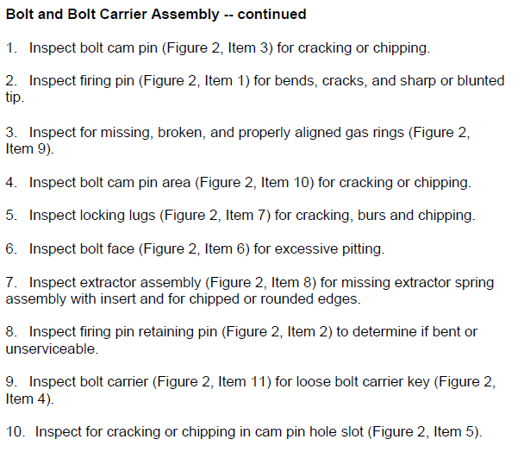
Inspect:
Bolt and Bolt Carrier Assembly

Slide 17
Maintain:
Bolt Carrier Assembly

Slide 18
Maintain:
Bolt and Carrier Assembly

Slide 19
Maintain:
Ejector

Slide 20
Inspect:
Magazine

Slide 21
Functions Check:
SAFE

Slide 22
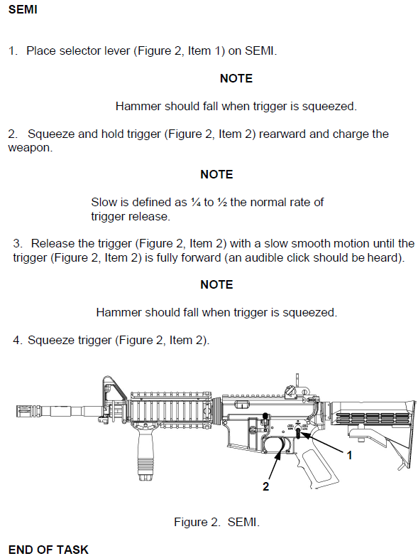
Functions Check:
SEMI

Slide 23
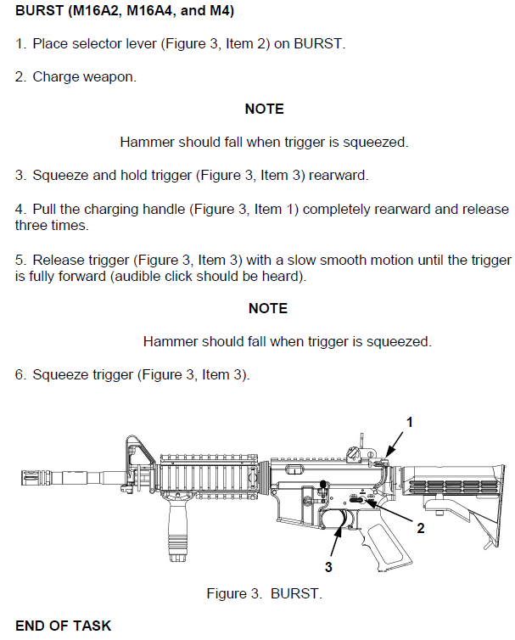
Function Check:
BURST

Slide 24
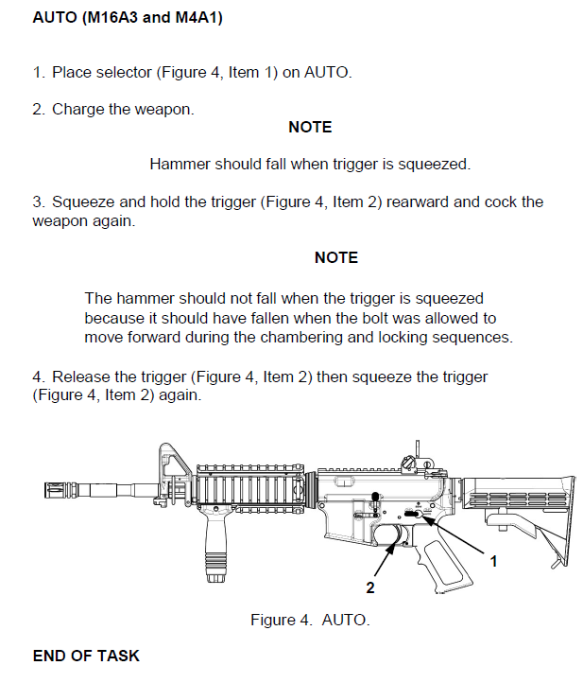
Function Check:
AUTO

Slide 25
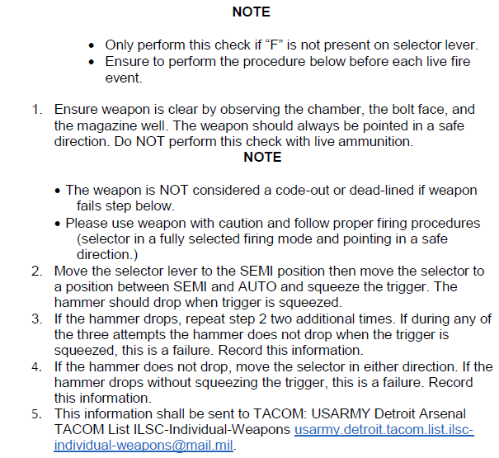
M4A1 Only: Selector Lever Check

Slide 26
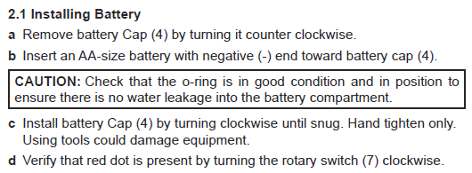
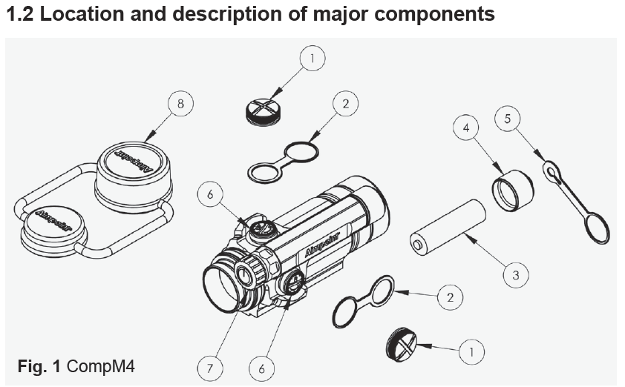
M68 CCO
Close Combat Optic

Slide 27
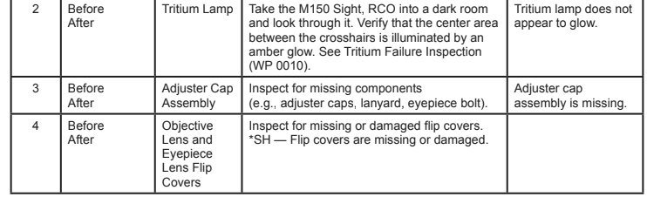
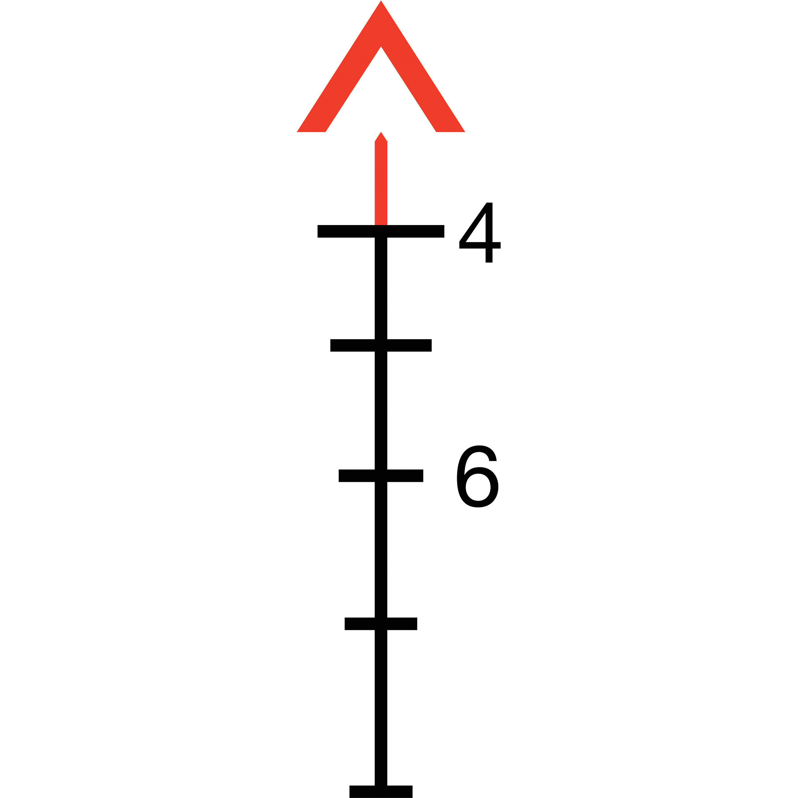
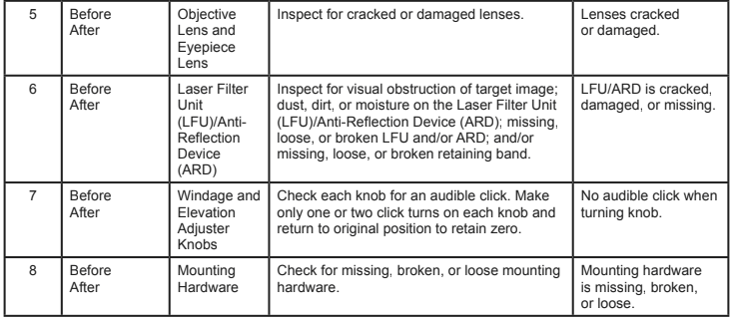
M150 RCO
Rifle Combat Optic

Slide 28
Notes:
The hammer of the trigger group falls striking the firing pin held in the center of the bolt and bolt carrier group which strikes the primer of the chambered cartridge. The primer detonates igniting the powder charge in the cartridge propelling the projectile forward and down the barrel, chamber pressure is in the range of 50,000 PSIA. As the projectile passes the gas port located on the lower side of the barrel (at the front sight block) a small portion of gas from combustion of the powder in the cartridge is directed into a gas tube that runs back to a small blocked tube on the bolt carrier group. The gas forces the bolt carrier group back against the buffer and buffer spring. As the bolt carrier group moves aft, the bolt rotates and unlocks from the lugs of the chamber. By this time the gas pressure in the barrel has dropped to nearly atmospheric pressure as the projectile leaves the barrel. All remaining actions are the result of the gas impinging on the blocked tube on the bolt carrier group and the resistance of the buffer and spring. F=MA roughly applies. The bolt unlocks, and moves rapidly backwards, pulling the spent cartridge case from the chamber. As it travels back the bolt telescopes to full extension as the carrier passes the hammer re-cocking the hammer and trigger group, and as it reaches nearly full extension aft, the ejector kicks the expended cartridge to the right and out of the action. The buffer spring now forces the bolt carrier group forward. The lower bolt edge strips a fresh cartiridge from the magazine moving it forward and upward along the chamber feed ramp into the chamber, the bolt following and engaging the cartridge base. As the cartridge seats in the chamber the bolt continues forward telescoping inwards. The lugs on the bolt enter the matching chamber notches and as the bolt ends forward travel, rotates right, locking the chamber.
In semi-automatic mode the next squeeze of the trigger repeats the cycle. In burst mode the trigger group uses a clockwork like mechanism to permit three full cycles of the sequence above before the hammer is locked in the cocked position, requiring another squeeze of the trigger to fire another burst. Fully automatic fire which is only availiable on M16, M16A1 and some M4 Carbine models, when selected, allows the cycle to continue until the trigger is released (let up on) or the weapon expends all ammunition in the magazine.
The M16 and variants ARE NOT the AR-15 and variants available to civilians in the US. The M16 is a select fire (semi, burst, full automatic) weapon which only those manufactured before 1986 may be possessed by civilians under significant restrictions and costs. Since the M16 / AR 15 design fires from what is called “closed bolt” it makes a poor fully automatic weapon.

