Slide 1
Identification and wear of the
Army Uniform
805-BT805065

Slide 2
Identification and Wear of
Army Uniform
Purpose and history of the military uniforms
The Army Combat Uniform (ACU)
Occasions for wear
Restrictions on wear
805-BT805065

Slide 3
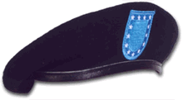
Army Combat Uniform
Head Gear
Patrol Cap
Fleece Cap
805-BT805065

Slide 4
Army Combat Uniform
COAT, ACU TOP
Coat Description
Wearing Guidelines
TROUSERS, ACU BOTTOM
Trouser Description
Wearing Guidelines
805-BT805065

Slide 5
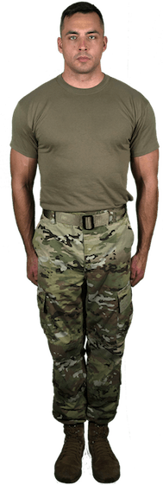
Army Combat Uniform

Slide 6
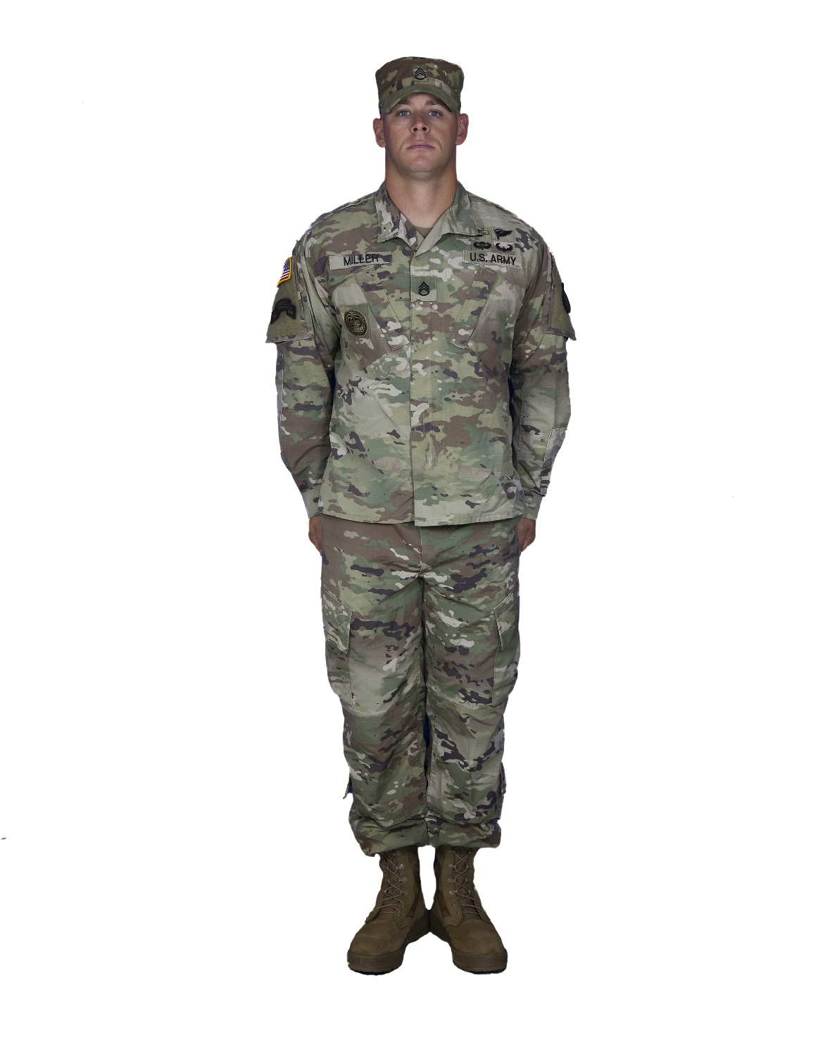
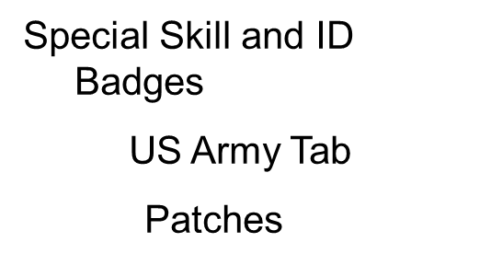
Army Combat Uniform
Name Tab
US Flag Insignia
Former Wartime Insignia Patch
Rank Insignia
805-BT805065

Slide 7
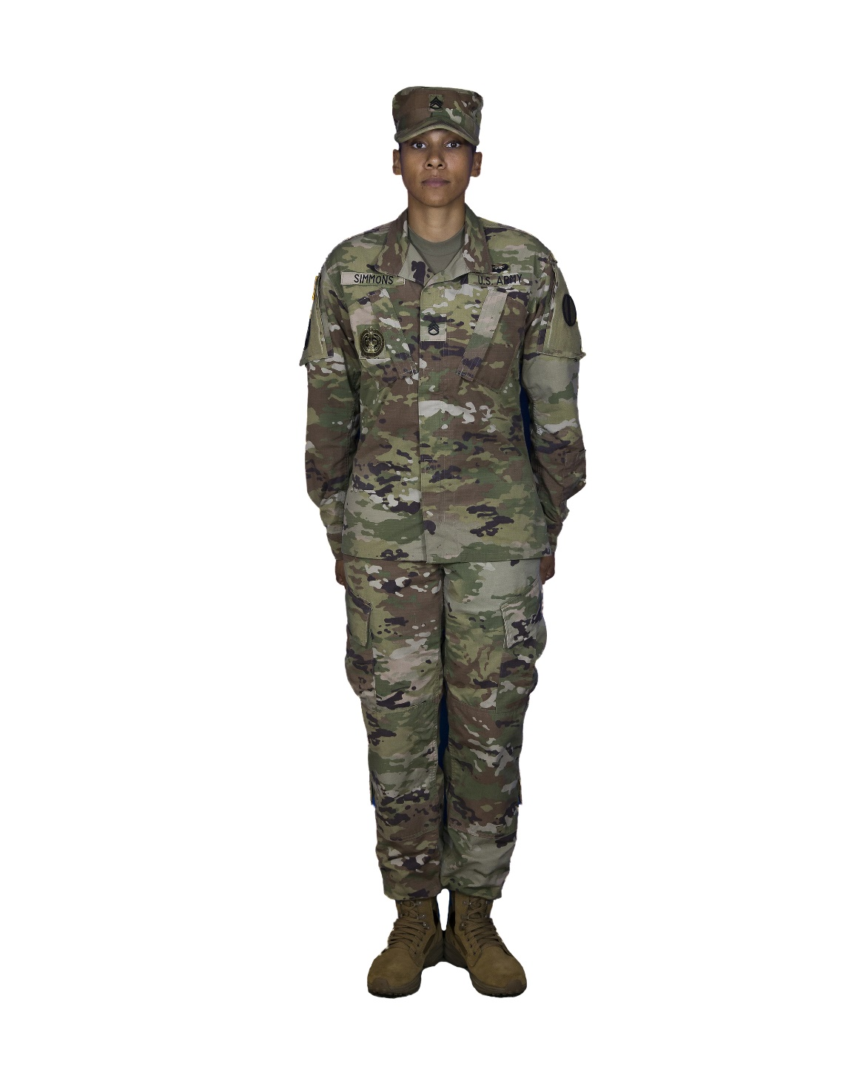
Army Combat Uniform
Name Tab
US Flag Insignia
Former Wartime Insignia Patch
Rank Insignia
805-BT805065

Slide 8
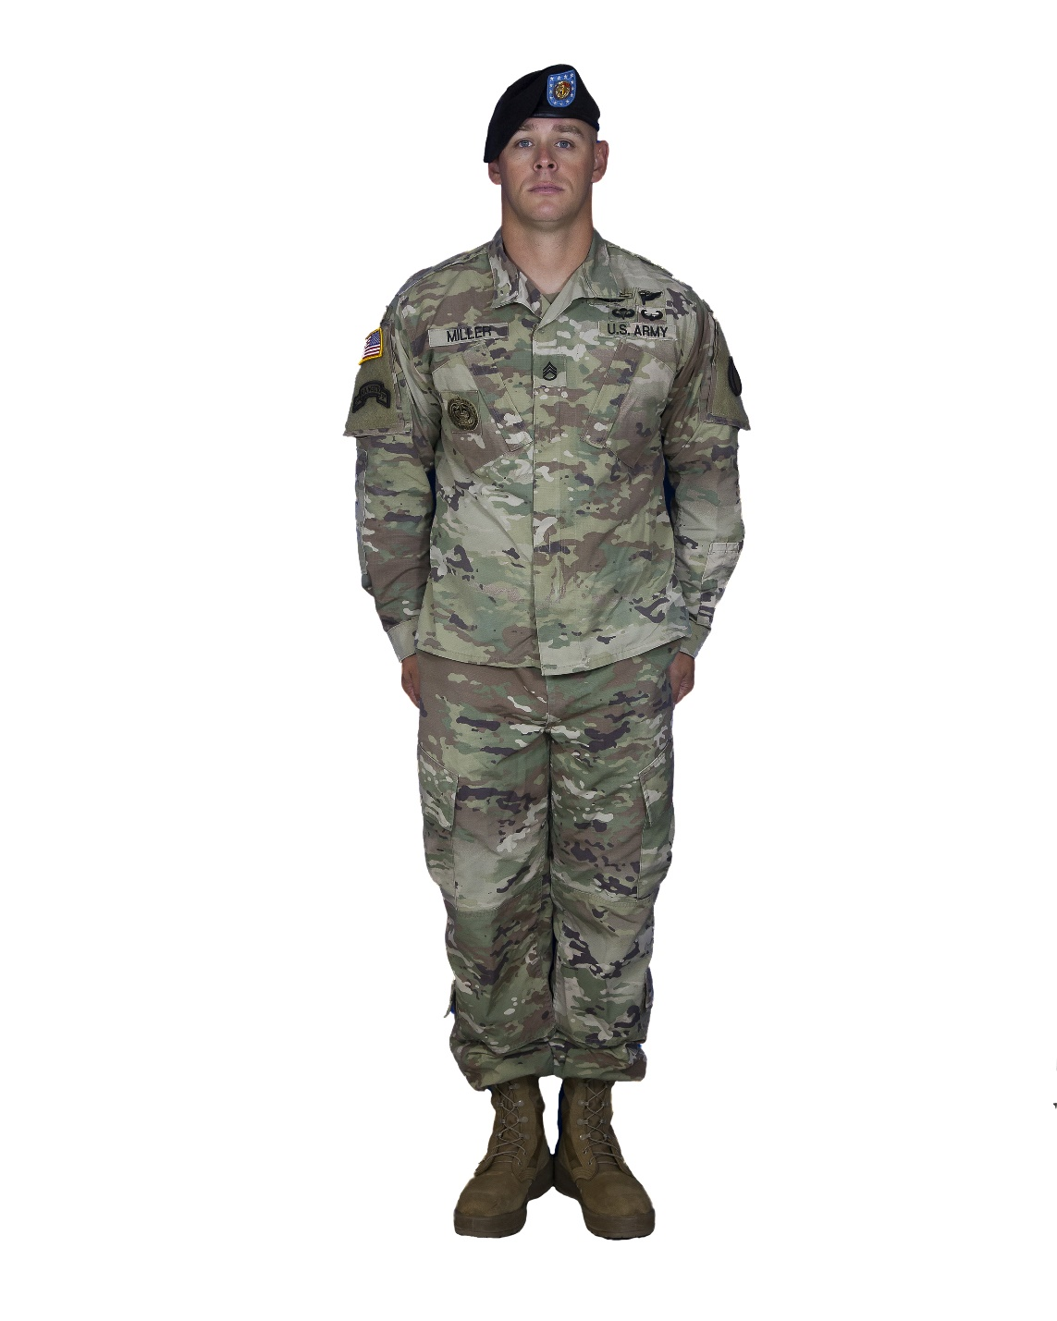
Army Combat Uniform
Name Tab
US Flag Insignia
Former Wartime Insignia Patch
Rank Insignia
805-BT805065

Slide 9
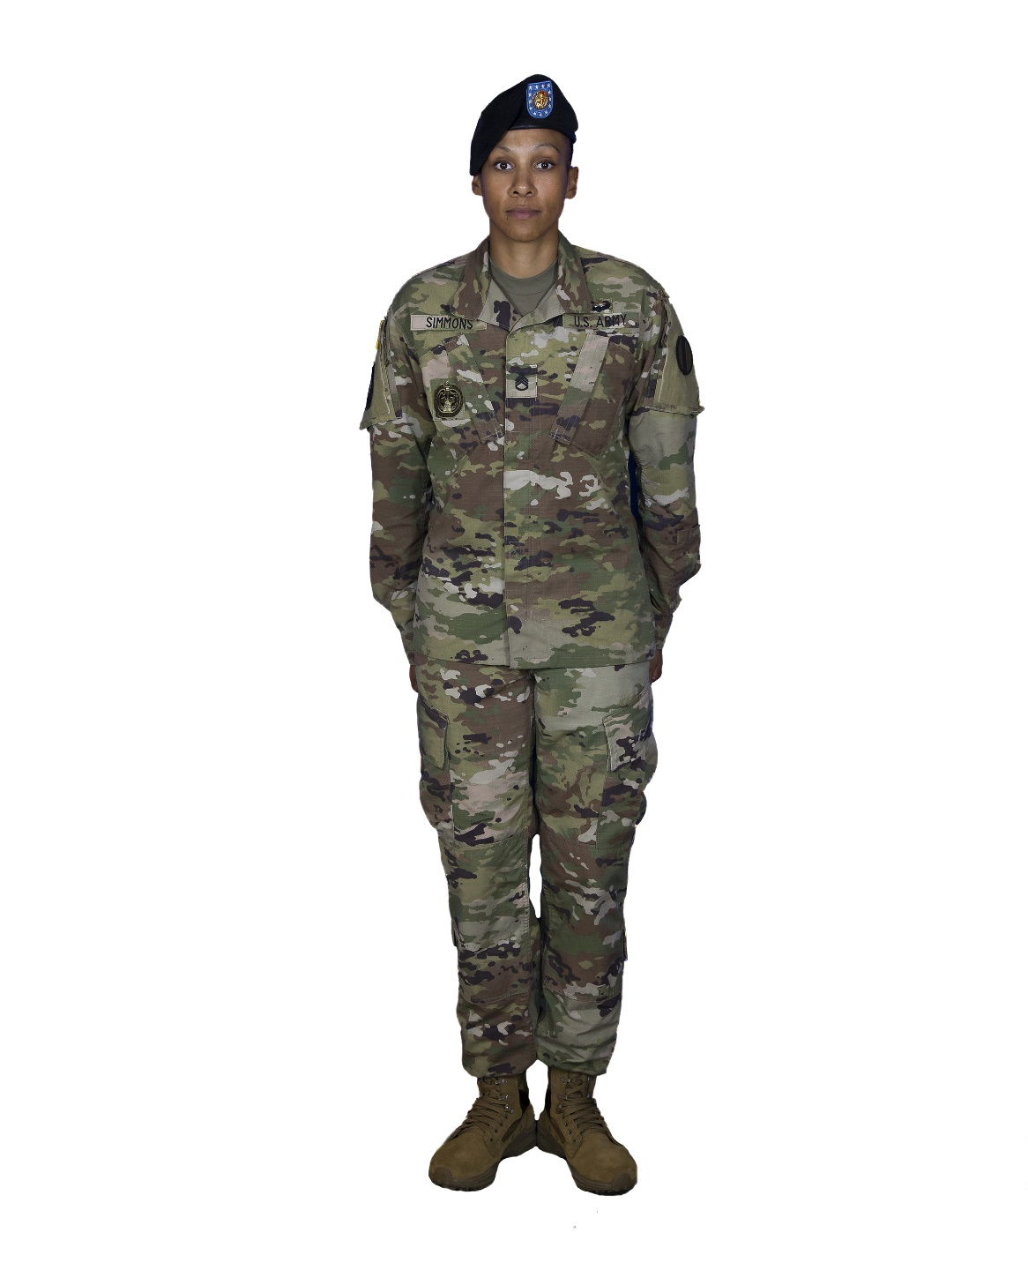
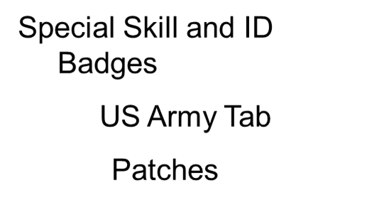
Army Combat Uniform
Name Tab
US Flag Insignia
Former Wartime Insignia Patch
Rank Insignia
805-BT805065

Slide 10
Army Combat Uniform
(CONT)
ACU Composition
Accessories
805-BT805065

Slide 11
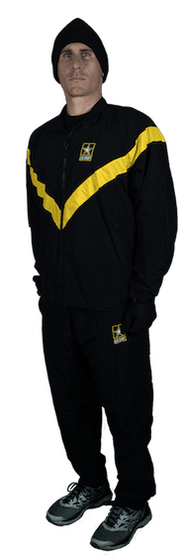
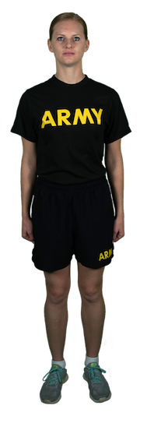
Physical Fitness Uniform
805-BT805065

Slide 12
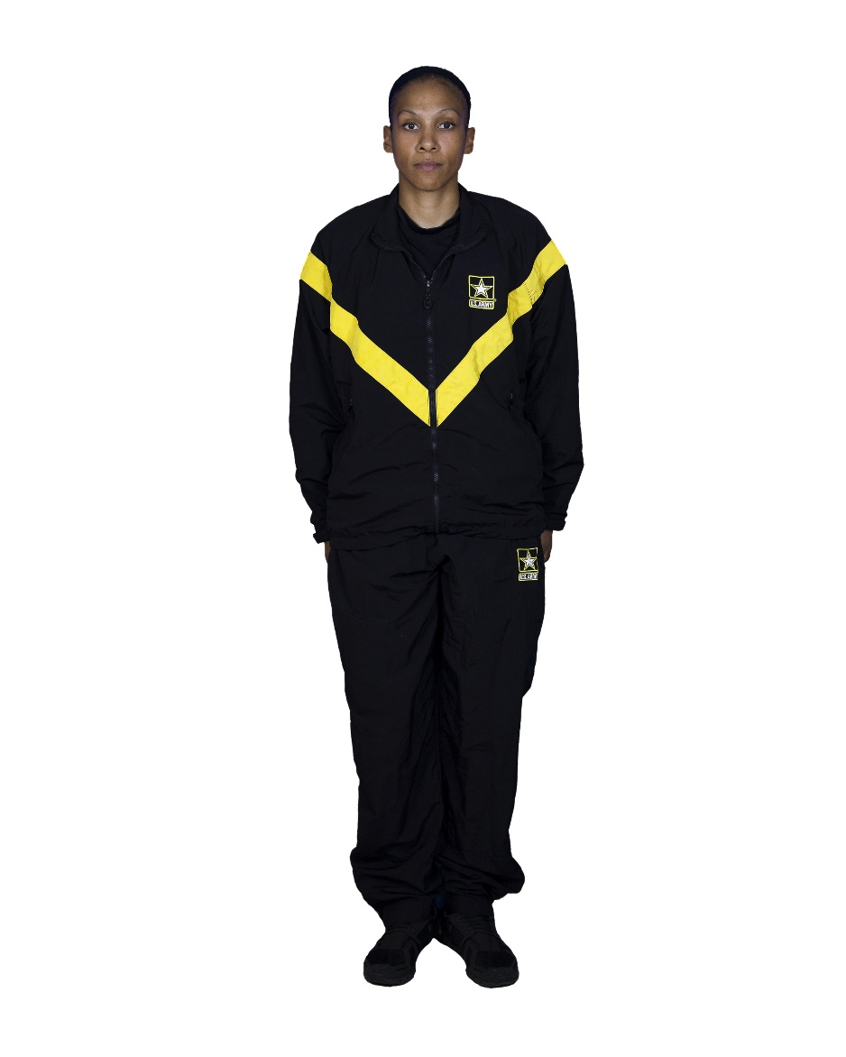
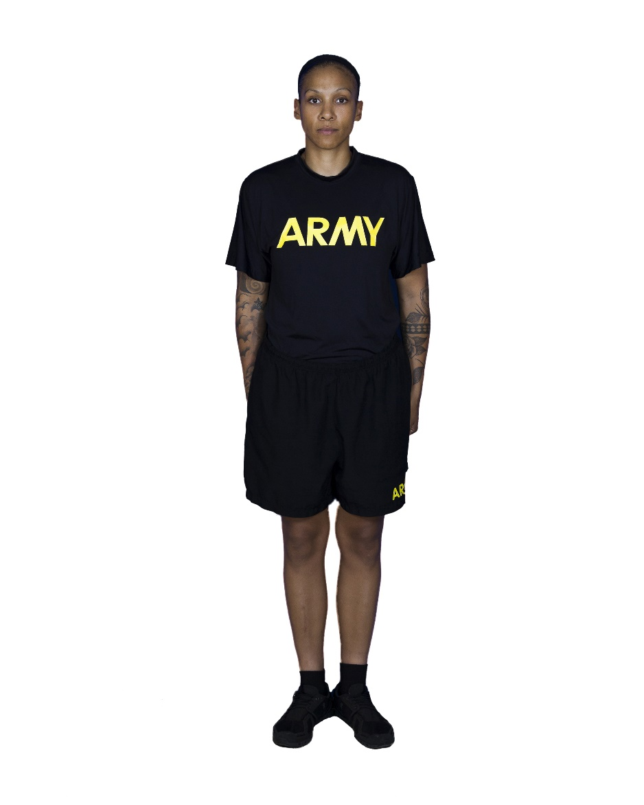
Physical Fitness Uniform
805-BT805065

Slide 13
Dress Uniforms
Male
Army Green Service Uniform
Occasions for Wear
Coat
Slacks
Skirt (optional for females)
Necktie
Undergarments
805-BT805065

Slide 14
Dress Uniforms (Cont)
Belt
Headgear
Footwear
Socks
805-BT805065

Slide 15
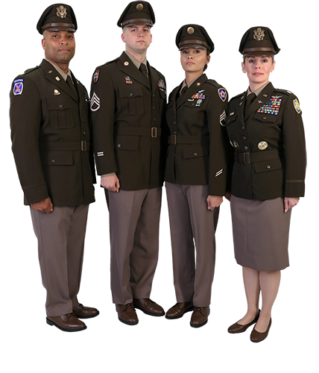
Army Green Service
Uniforms
805-BT805065

Slide 16
IDENTIFICATIONS AND WEAR OF MILITARY UNIFORM
Clothing Maintenance Allowance
Care and Maintenance of Army Uniforms
805-BT805065

