Slide 1
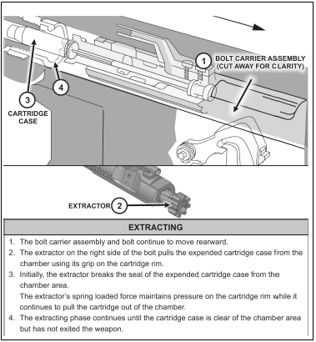
PRINCIPLES OF OPERATION
Notes:
Extracting is the removal of the expended cartridge case from the chamber by
means of the extractor

Slide 2
Extracting

Slide 3
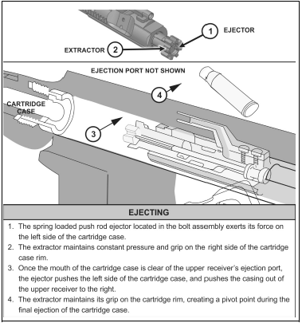
PRINCIPLES OF OPERATION
Notes:
Ejecting is the removal of the spent cartridge case from the weapon itself

Slide 4
Ejecting

Slide 5
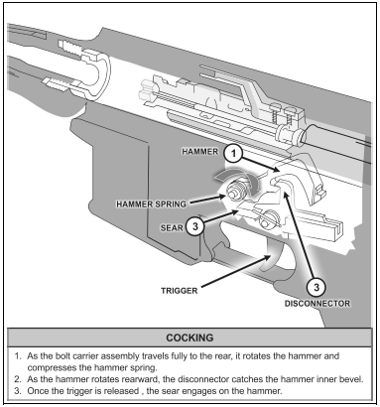
PRINCIPLES OF OPERATION
Notes:
Cocking is the process of mechanically positioning the trigger assembly’s parts for firing (see figure 2-10). The cocking phase completes the full cycle of functioning.

Slide 6
Cocking

Slide 7
Trigger Operations Single Fire/Auto

Slide 8
Operation of the Forward Assist

Slide 9
Function of the Magazine Follower

Slide 10
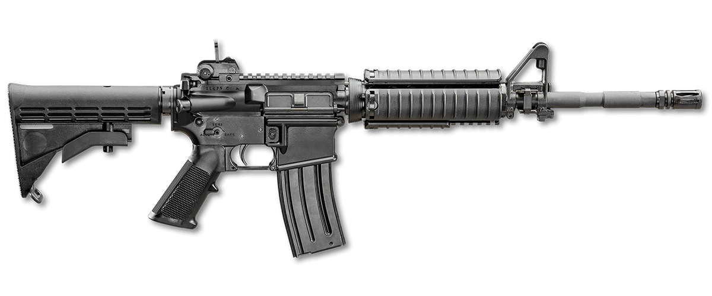
PRINCIPLES OF OPERATION
COOLING
Convection
Conduction
Radiation
Notes:
There are three methods to reduce the thermal stress on a weapon. The M4- and M16-series of weapons use all three of these methods to varying degrees to cool the chamber, bore, and barrel to facilitate continuous operation. These methods of cooling are—
● Radiation cooling – allows for the dissipation of heat into the surrounding cooler air. This is the least efficient means of cooling, but is common to most small arms weapons, including the rifle and carbine.
● Conduction cooling – occurs when a heated object is in direct physical contact with a cooler object. Conduction cooling on a weapon usually results from high chamber operating temperatures being transferred into surrounding surfaces such as the barrel and receiver of the weapon. The transfer from the chamber to the cooler metals has the net effect of cooling the chamber. Thermal energy is then carried away by other means, such as radiant cooling, from these newly heated surfaces.
● Convection cooling – requires the presence of a moving air current. The moving air has greater potential to carry away heat. The hand guards and ARS of the rifle and carbine are designed to facilitate air movement. The heat shield reflects heat energy away from the hand guard and back towards the barrel. The net effect is an updraft that brings the cooler air in from the bottom. This process establishes a convection cycle as heated air is continually replaced by cooler air.

Slide 11
CHECK ON LEARNING
PRINCIPLES OF OPERATION
What are the major components?
Upper Receiver
Lower Receiver
What are the cycle of function?
● Feeding.  Chambering.  Locking.  Firing.  Unlocking.  Extracting.  Ejecting.  Cocking.
What are the methods of cooling?
● Radiation Cooling
● Conduction Cooling.
● Convention Cooling
Notes:
Range overmatch provides a tactical engagement buffer that accommodates the Soldier’s time to engage with precision fires. For example, a Soldier that has the capability to effectively engage personnel targets at a range of 500 meters will have range overmatch of 10 to 20 percent over a threat rifleman. That 10 to 20 percent range difference is equivalent to a distance of 40 to 80 meters, which is approximately the distance a maneuvering threat can traverse in 15 to 40 seconds

