Slide 1
LSA 8:
Borelighting
Notes:
Begin by asking pointed question to get concrete knowledge of the class:
Example questions
What are uses of a bore light?

Slide 2
ACTION:
Demonstrate knowledge of Army service Rifle preliminary marksmanship instruction.
CONDITION:
In a classroom environment, given TC 3-22.9, Rifle and Carbine.
STANDARD:
Identify how to apply and train Rifle Marksmanship utilizing the US Army Service Rifle in accordance with applicable command guidance, TC 3-22.9 Rifle and Carbine and TC 3-20.0 Integrated Weapons Training
Strategy.

Slide 3
INTRODUCTION
Safety Considerations:
Risk Assessment:
Environmental Considerations:
Evaluation:
Notes:
Safety Considerations: Fire escape plan should be reference
Risk Assessment: Low
Environmental Considerations: Keep tops on bottles when not in use and remember to remove all trash from the classroom.
Evaluation: You will be evaluated formally on written examinations which you must achieve a minimum of 70% to continue the course.

Slide 4
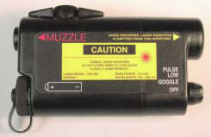
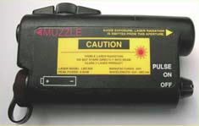
LASER BORE-LIGHT SYSTEM
A/N PEM-1
LBS-300-A2
LBS-050
Notes:
This slide illustrates the different types of Laser Boresights Available to the Soldier. The majority have the LBS-300, also known as the A/N PEM-1.
4

Slide 5
LASER BORE-LIGHT SYSTEM
Item |  | LBS-300 | LBS-50
1 | Laser Bore-light Assembly | X | X
2 | Soft Carrying Case | X | X
3 | Mandrels (5.56mm, 7.62mm, .50 cal) | X | X
4 | Boresight Targets (1-38) | X
5 | Warning Device |  | X
6 | Operator and Unit Maintenance Manual | X
7 | Battery, AA (2) X | X | X
8 | 10m Line Distance Gage | X | X
Foreign Disclosure 1
Notes:
5
Description of Major Components:
Bore-light Assembly: The Bore-light assembly is a compact; lightweight advanced Electro-optical assembly, which provides a highly collimated beam of visible energy for weapon aiming.
Mandrels: Mandrels are selectable metal rods, which screw into the rear of the Bore-light and are designed to fit the muzzle of the selected weapon in three different calibers which are 5.56mm, 7.62mm, .50 Cal:
NOTE: There is an adapter designed to boresight the MK-19. It fits inside the barrel of the MK-19. Once installed, the 5.56mm mandrel is inserted into the the MK-19 adapter.
10 Meter String: The 10-Meter String/Cord provides a precise measurement tool for spacing the Bore-light from the target when performing the boresighting procedure.
Battery (AA): A single AA battery is used as a power supply for operating the Bore-light. The use of a high quality battery is recommended.
TM Manual: The manual details operation, maintenance and general information on the Bore-light.
Carrying Bag: The Bore-light is supplied with a carrying bag. The bag is made out of waterproof fabric, neatly holds all components, and is easily attached to the web belt.
Boresight Targets - Scale 1 CM X 1 CM: Ideally, the targets are laminated for outdoor use. The targets have markings for predetermined weapon offsets as derived from the weapon and sight combinations. These offsets when transferred to the weapon will boresight the weapon for 300M, 400M, and 500M.(Depends on weapon system being boresighted)
NOTE: The 10M Boresight Targets that come with the Bore-light are only part of the weapon/ sight configurations that the Bore-light supports. All the various 10M Boresight Targets can be gotten from the BDE Master gunner.

Slide 6
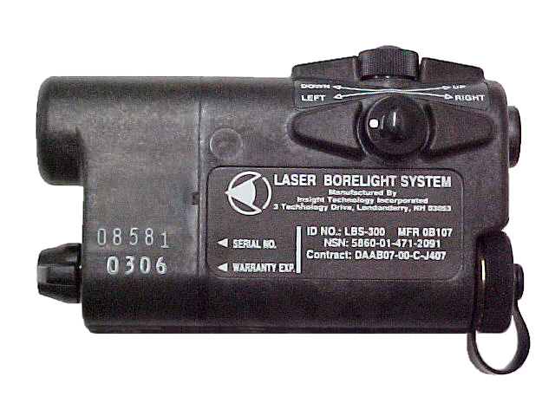
LASER BORE-LIGHT SYSTEM
CONTROLS
LEFT SIDE
ELEVATION
ADJUSTER
WINDAGE
ADJUSTER
TOP = ELEVATION
SIDE = WINDAGE
Notes:
6
Bore-light: Left side
The left side of the Bore-light houses the windage adjuster. Located above the windage adjuster is the elevation adjuster.
Regardless of the Bore-light’s position, the adjuster that is on the top or bottom changes the elevation. The adjuster that is on the side changes the windage. Adjustment knob movement has tactile clicks. Each click moves the beam 2mm at 10 meters. The Bore-light adjustment knobs move the beam in true horizontal and vertical directions.
ADJUSTMENT KNOB ROTATION: Directional arrows are labeled between the adjustment knobs which states the way to rotate the adjustment knobs in order to move the beam either vertically or horizontally.
Zeroing The Bore-light Beam Adjustment knob movement Beam movement
Top adjustment knob (Elevation) CW Up
CCW Down
Side adjustment knob
Azimuth (windage) CW Right CCW Left

Slide 7
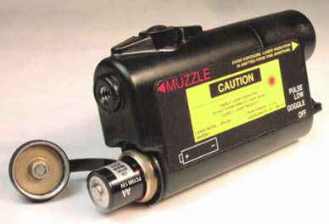
LASER BORE-LIGHT SYSTEM
PLACE INTO OPERATION
(1) INSERT BATTERY
(2) ATTACH MANDREL
Appropriate Mandrel
Notes:
7
READ:
a. Battery Installation: To install the battery, simply unscrew the battery cap and install a single AA battery. Orient the battery with the positive end facing the battery cap. A (+) sign is provided inside the battery cap along with the diagram on the Bore-light body for reference.
b. Mandrel attachment: Screw the appropriate mandrel into the Bore-light and hand tighten only.

Slide 8
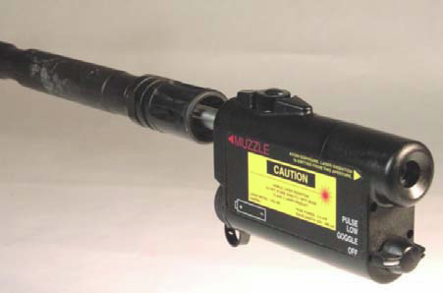
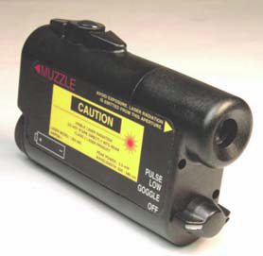
LASER BORE-LIGHT SYSTEM
PLACE INTO OPERATION
(3) INSERT INTO BARREL
(Clear weapon)
(4) TURN
ON LASER
Notes:
8
READ:
c. Insert into barrel: Insert the mandrel into the barrel of the weapon until it stops. The Bore-light should spin smoothly with little resistance or force.
d. Turn on Bore-light: Turn the Mode Selector switch to the desired position needed for operation.
NOTE: Ensure that the Bore-light is turned on only after it has been inserted into the weapon and is pointing at a surface 10 meters away.

Slide 9
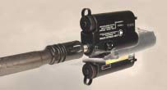
LASER BORE-LIGHT SYSTEM
ZERO BORE-LIGHT
Rotating the Bore-light must always be done in a counterclockwise (CCW) direction (as viewed from above and behind the Bore-light)
Notes:
9
Read: During the Zeroing Process, the Bore-light will be turned Counterclockwise (from the Gunner’s perspective). Turning the Bore-light in the opposite direction can cause it to loosen and come off the end of the mandrel.
Bore-light communication: Zeroing the Bore-light is a two-man process so it can be done in a timely manner. Each person must know how to communicate the process. There are commands that are given so that the soldier at the target and the soldier at the weapon know exactly what to do and when to do it. The soldier at the target is the one who controls the process and gives the commands. The soldier at the weapon repeats the commands given after accomplishing them so the soldier at the target knows when to continue with the procedure.

Slide 10
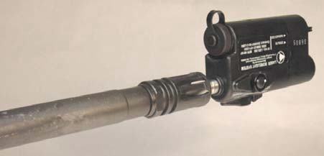
LASER BORE-LIGHT SYSTEM
ZERO BORE-LIGHT
START POINT
BATTERY COMPARTMENT FACING UP
NOTE: ALWAYS ALIGN THE ZEROING MARK AT START POINT.
Notes:
10
READ: There are two commands that need to be learned in order to successfully zero the Bore-light.
They are:
START POINT is the first command given. When the command of START POINT is given the soldier at the weapon will rotate the Bore-light so that the battery compartment is in the up position. The soldier at the target will align the zero mark with the Bore-light laser once the Bore-light is in the start position.

Slide 11
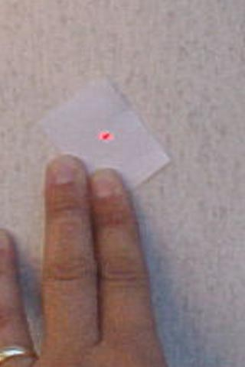
LASER BORE-LIGHT SYSTEM
ZERO MARK
A “Zeroing mark” could be a piece of tree bark, or a dot on a piece of paper as seen here.
Move zeroing mark to start point.
Only align when in the start point position.
Notes:
11
ZEROING MARK: The zeroing mark can be anything that can be marked with a small dot. Examples of a zeroing mark are, a piece of bark with a dot carved into it, a SKOAL can, for soldiers who dip, that has the dimple in the back of the can, or a piece of paper with a dot drawn on it as seen on the slide animation.
THINGS TO KNOW ABOUT THE ZEROING MARK:
It is centered on the Bore-light laser only when the Bore-light laser is in the start position.
It is not taped to a surface. (It must be able to be moved freely)
It is held firmly in place with hand pressure.
Once the Bore-light is turned to the HALF TURN position, the zeroing mark does not move until adjustments have been made to the Bore-light and the Bore-light is ready to be moved back to the START POSITION.
NOTE:
If the ZEROING MARK moves after the command of HALF TURN is given, tell the soldier at the weapon to turn the Bore-light back to the START POSITION and realign the zeroing mark onto the Bore-light laser. This will speed up the zeroing process by preventing incorrect adjustments from being made to the Bore-light.
At this time:
Using the the slide animation show the students how to center the zeroing mark onto Bore-light laser.

Slide 12
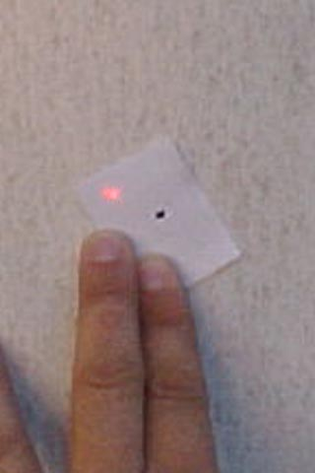
LASER BORE-LIGHT SYSTEM
REFERENCE POINT
Reference Point
Turn Bore-light Counter Clockwise (CCW) to the half turn position from start point.
Adjust Bore-light adjusters until the laser is halfway between the start point and the half turn position. This is known as the Reference Point.
Half Turn
X
Start Point
NOTE: ALWAYS TURN
COUNTER CLOCKWISE FROM THE SHOOTER’S PERSPECTIVE.
Notes:
12
READ: REFERENCE POINT: When the Bore-light is not zeroed to the weapon, it rotates away from the zeroing mark once it is placed in the HALF TURN position. The point that is half way between the zeroing mark (START POINT) and were the Bore-light laser lands when it is in the HALF TURN position is the REFERENCE POINT.
THINGS TO KNOW:
When the Bore-light is extremely un-zeroed, gross adjustments can be made to the Bore-light to move the laser to the reference point
When the Bore-light is un-zeroed, the Bore-light laser travels the circumference of a circle. By adjusting the Bore-light laser half way between the zeroing mark (START POINT) and were the Bore-light laser lands when it is in the HALF TURN position, the laser is traveling the circumference of a smaller circle with each series of adjustments.
If the Bore-light laser is adjusted back to the zeroing mark, the Bore-light laser will land exactly in the opposite side from the previous series of adjustments
AT THIS TIME REMIND:
The students to always turn the Bore-light Counter Clockwise from the gunner’s point of view.

Slide 13
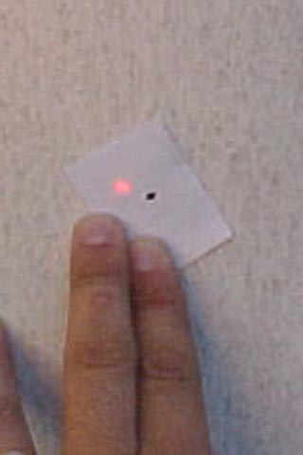
LASER BORE-LIGHT SYSTEM
ZERO LASER
EXAMPLE:
REPEAT THESE STEPS UNTIL THE LASER SPINS ON ITSELF
X
HALF TURN AND START POINT ARE THE SAME
LASER SPINS ON ITSELF W/IN A 1 CM CIRCLE
Notes:
13
READ: It is important to point out that although the standard is for the laser to spin on itself within a 1 CM circle, the closer the student gets to getting the laser to spin on itself the better off they will be for accurately engaging farther targets. This is especially the case with dealing with aiming lasers. An error of 1cm at 10m will grow exponentially out to range. For example, accepting a 1 cm deviation with an M4/PEQ-15 Combination means you will be off 11.8 INCHES at 300 meters.
STEPS TO ZERO THE Bore-light.
Now that you are familiar with the verbal commands, the positions of the Bore-light during the zeroing procedure, and where to adjust the Bore-light laser when zeroing it, lets go through all the steps.
Bore-light zeroing procedure:
Stabilize the weapon: Stabilize the weapon in a rifle box, sand bags, tripod or rucksack.
NOTE:
Orientation of the weapon is irrelevant. The weapon does not have to be perfectly level when zeroing the Bore-light.
NOTE:
The 10 meter measurement to the boresight target should be measured from the end of the flash suppressor.
Insert the mandrel into the muzzle of the weapon: The Bore-light is seated properly when no further travel of the mandrel into the muzzle is permitted and the Bore-light rotates with very little resistance. The soldier at the weapon places the Bore-light in the START POINT position
Turn the Bore-light on: With the help of an assistant, place a stable flat surface approximately ten meters from the end of the barrel so that the laser dot strikes it when the Bore-light is in the muzzle of the weapon.
REMEMBER: The soldier at the target is the one who controls the process and gives the commands. The soldier at the weapon repeats the commands given after accomplishing them so the soldier at the target knows to continue with the procedure.
START POINT: When the command of START POINT is given, the soldier at the weapon will rotate the Bore-light so that the battery compartment is in the up position( If necessary). The soldier at the target will align the zero mark with the Bore-light laser.
HALF TURN: When the command of HALF TURN is given, the soldier at the weapon will slowly rotate the Bore-light 180 degrees CCW from the gunner’s point of view until the battery compartment is in the down position and the adjustment knobs are on top. As the Paratrooper is rotating the Bore-light to the HALF TURN position, the soldier at the target is observing the movement of the Bore-light laser. The soldier at the target will note the position of the Bore-light laser and will select the reference point
ADJUSTMENTS: The soldier at the target will tell the soldier at the weapon what adjustments need to be made to the Bore-light in order to move the Bore-light laser to the reference point.
Once the corrections have been made the soldier at the target will give the command of START POINT. Steps 4 through 6 will be repeated until the Bore-light laser spins on itself or spins within a 1 centimeter circle.
Bore-light Zero Check: The Bore-light laser is zeroed when it spins on itself or spins within a 1 centimeter circle once it is turned 180 degrees from the START POINT to the HALF TURN position. The weapon - sight combination is now ready to be boresighted.
NOTE:
Do not remove the Bore-light from the weapon. If removed you must zero the Bore-light again to the weapon
AT THIS TIME: Activate the animation on this slide to show what a zeroed Bore-light looks like.
THINGS TO REMEMBER:
The weapon system must be stable. Use a tripod, shadow box, sand bags, or a rucksack to stabilize the weapon.
Zero the Bore-light to every single weapon being boresighted. (Every barrel is different)
Start point is with the battery compartment UP.
Half turn is with the battery compartment DOWN.
Measure 10 meters from the muzzle of the weapon.
Keep the zeroing mark stable, but do not attach it to a surface. The zeroing mark’s position will constantly change until the Bore-light is zeroed.
Rotate the Bore-light counterclockwise as from the perspective of the Paratrooper. If rotated in the opposite direction the mandrel will unscrew from the Bore-light.
Always align the zeroing mark when the Bore-light is in the start point position.
Make adjustments to the Bore-light until the laser dot is half the distance between the zero mark and the position of the laser after a half turn was made.
Bore-light is zeroed ONLY when the laser spins on itself.
Do not remove the Bore-light from the weapon until after boresighting procedures are completed
NOTE: If you can't find the Bore-light on the offset move the offset to two meters and start there.
NOTE: It is convenient to start with the adjuster pointing down but not necessary.

Slide 14
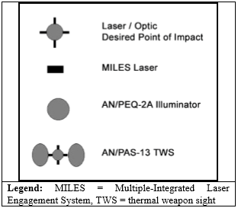
LASER BORE-LIGHT SYSTEM
BORE-LIGHT DOCTRINAL SYMBOLS
Notes:
14
Use the appropriate symbol for the equipment when we create Bore-light templates.
Notes. 1. To reproduce the 10-meter target offset, obtain a copy of the blank 10-meter target offset and place the example of the weapon being used on the back. This reproducible copy can be laminated and used repeatedly.

Slide 15
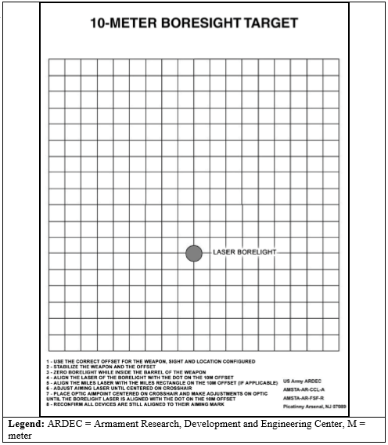
LASER BORE-LIGHT SYSTEM
BORE-LIGHT TARGET
Notes:
15
The boresight target shows the desired relationship between the bore of the weapon and the firer’s aiming point, which varies with the weapon/sight system combination. Different symbols are used for designating different sights/optics, and so forth. All Bore-lighting is done at 10 meters.

Slide 16
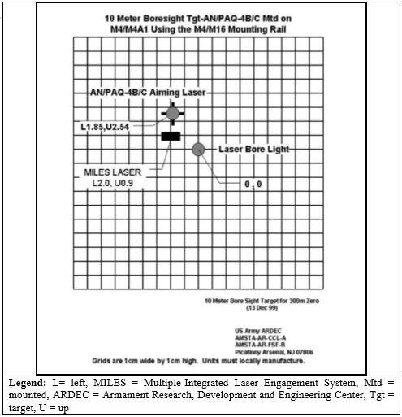
LASER BORE-LIGHT SYSTEM
TARGET WITH PROPER SYMBOLS
Notes:
16
Label that target with the weapon system, aiming device and mountable equipment.

Slide 17
LASER BORE-LIGHT SYSTEM
TARGET WITH PROPER SYMBOLS
Notes:
17
Label the symbol with the appropriate measurements. Mark L/R for Left and Right, Mark U/D for Up and Down.

Slide 18
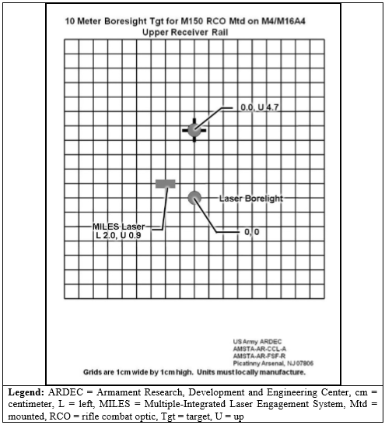
LASER BORE-LIGHT SYSTEM
TARGET WITH PROPER SYMBOLS
Notes:
18

Slide 19
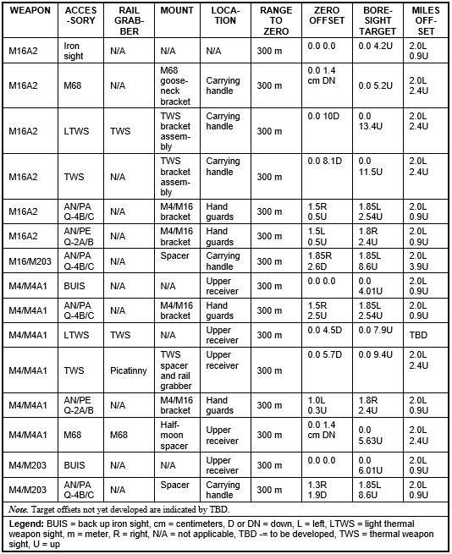
LASER BORE-LIGHT SYSTEM
BORE-LIGHT OFF-SETS
Note: Always Check and Reference the TM for Bore-light Off-Set
Notes:
19
Appendix G; Borelighting

Slide 20
CHECK ON LEARNING
CONTROL
What are the commands while conducting bore lighting operations?
Start position, and half turn
What are the settings on the A/N PEM-1 Used for?
● Boresighting optics
● Boresighting Lasers
● Dry Fire w/ Feedback
● Confirming zero

